Slide 1
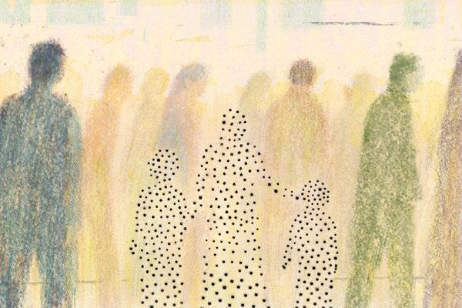
The Importance of Financial Inclusion for People with Disabilities
Michael Morris
Executive Director
National Disability Institute
Artist: Dadu Shin

Slide 2
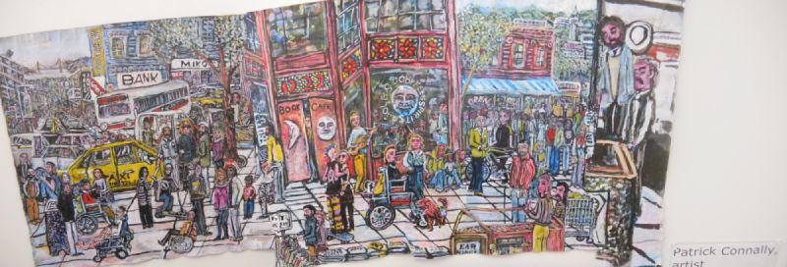
Financial Inclusion is …
Artist: Patrick Connally, Downtown Berkeley
Accessible and affordable financial services
Financial education to make informed financial decisions

Slide 3
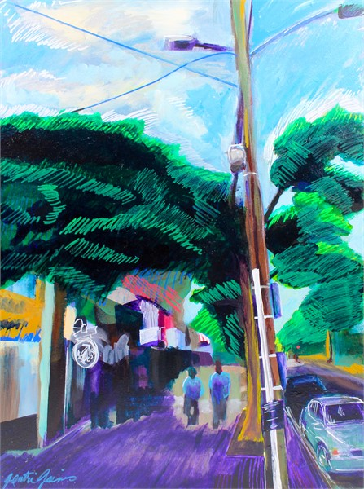
For People with Disabilities,
Financial Inclusion is …
Not a fringe issue
Fundamental to the definition of community
Fundamental to solving other intractable social issues
Artist: Gen Gaines, A Summer Stroll on RIA

Slide 4
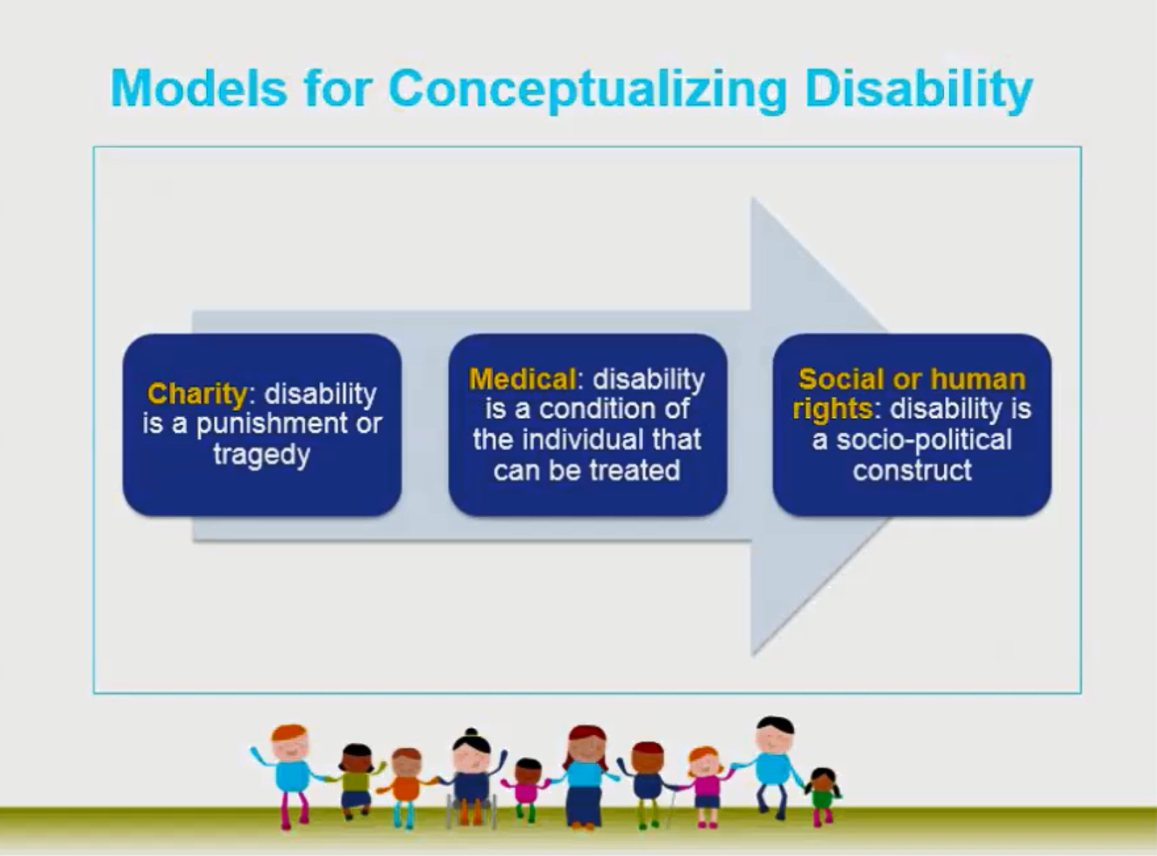
What is Disability: Changing Conceptualization
Medical model
  Says that a disability is a condition within a person and that the only way to address that condition is to “fix” the person.
Social Model
  Says that disability is an interaction between the person and the environment—that people are limited by barriers in society, not solely by their disability. These barriers can be physical, programmatic or attitudinal.
Therefore, our job is to adjust the financial environment to meet the needs of ALL.
For a good description of the Social model see “The Social Model of Disability” by Tom Shakespeare in The Disability Studies Reader, 2017. https://books.google.com/books?hl=en&lr=&id=aiQlDwAAQBAJ&oi=fnd&pg=PA195&dq=tom+shakespeare+social+model&ots=TAzrb-LDo-&sig=A78tLWkL6FvxX2ZlxeWpkfhBgEc#v=onepage&q=tom%20shakespeare%20social%20model&f=false

Slide 5
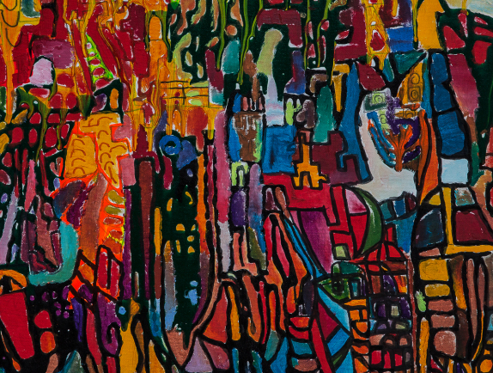
Who Are People with Disabilities?
40-57 million people
13-20% of total population
26% of households have a member with a disability
Diverse in terms of type of disability, race, age, age of onset, socioeconomic situation
Artist: Liam Hassan Beserekumo, untitled

Slide 6
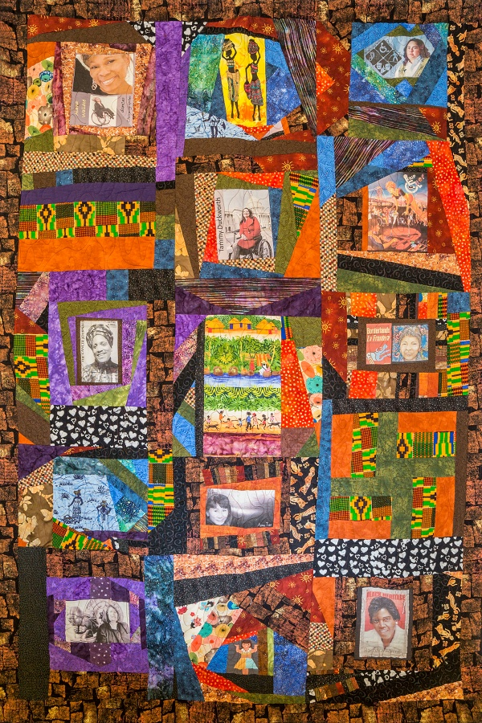
Intersectionality of Disability and Other Identities
The American Community Survey estimates 14% of African Americans, 14% of Whites and 9% of Latinos have a disability.
The prevalence of disability increases with age.
Some research suggests the prevalence of disability is higher among LGBTQ adults compared with their heterosexual counter parts.*
*Karen I. Fredriksen-Goldsen, Hyun-Jun Kim, and Susan E. Barkan (2012) Disability Among Lesbian, Gay, and Bisexual Adults: Disparities in Prevalence and Risk. American Journal of Public Health. 102(1).
Artist: Corbett O’Toole, Disabled Women of Color

Slide 7
The Intersection of Disability, Color and Poverty
Race and disability are not completely separate sources of disadvantage that parallel each other. Race and disability are overlapping identities that are both related to systemic inequality.
NDI has documented disparities by disability and color in poverty rate, educational attainment, employment status, use of financial services and financial stress.

Slide 8
Unbanked: Disability Gap Is Growing
Source: 2011-2017 FDIC Surveys of Unbanked and Underbanked Households

Slide 9
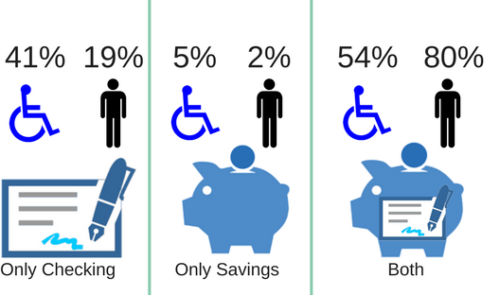
Use of Accounts by Banked Households
Even among households with bank accounts …
Households with a disability less likely to have both a checking and savings account.
Households with a disability are much less likely to use online banking (47% compared with 73%).
More likely to use the bank teller as the primary method to access their accounts.
39%
18%
4%
1%
57%
80%
Source: 2017 FDIC Surveys of Unbanked and Underbanked Households

Slide 10
Financial Exclusion Leads to Potentially Expensive Use of Alternative Financial Services
Source: 2017 FDIC Surveys of Unbanked and Underbanked Households

Slide 11
Difficulty Covering Expenses and
Making Ends Meet
Source: FINRA Investor Education Foundation, National Financial Capability Survey, 2015

Slide 12
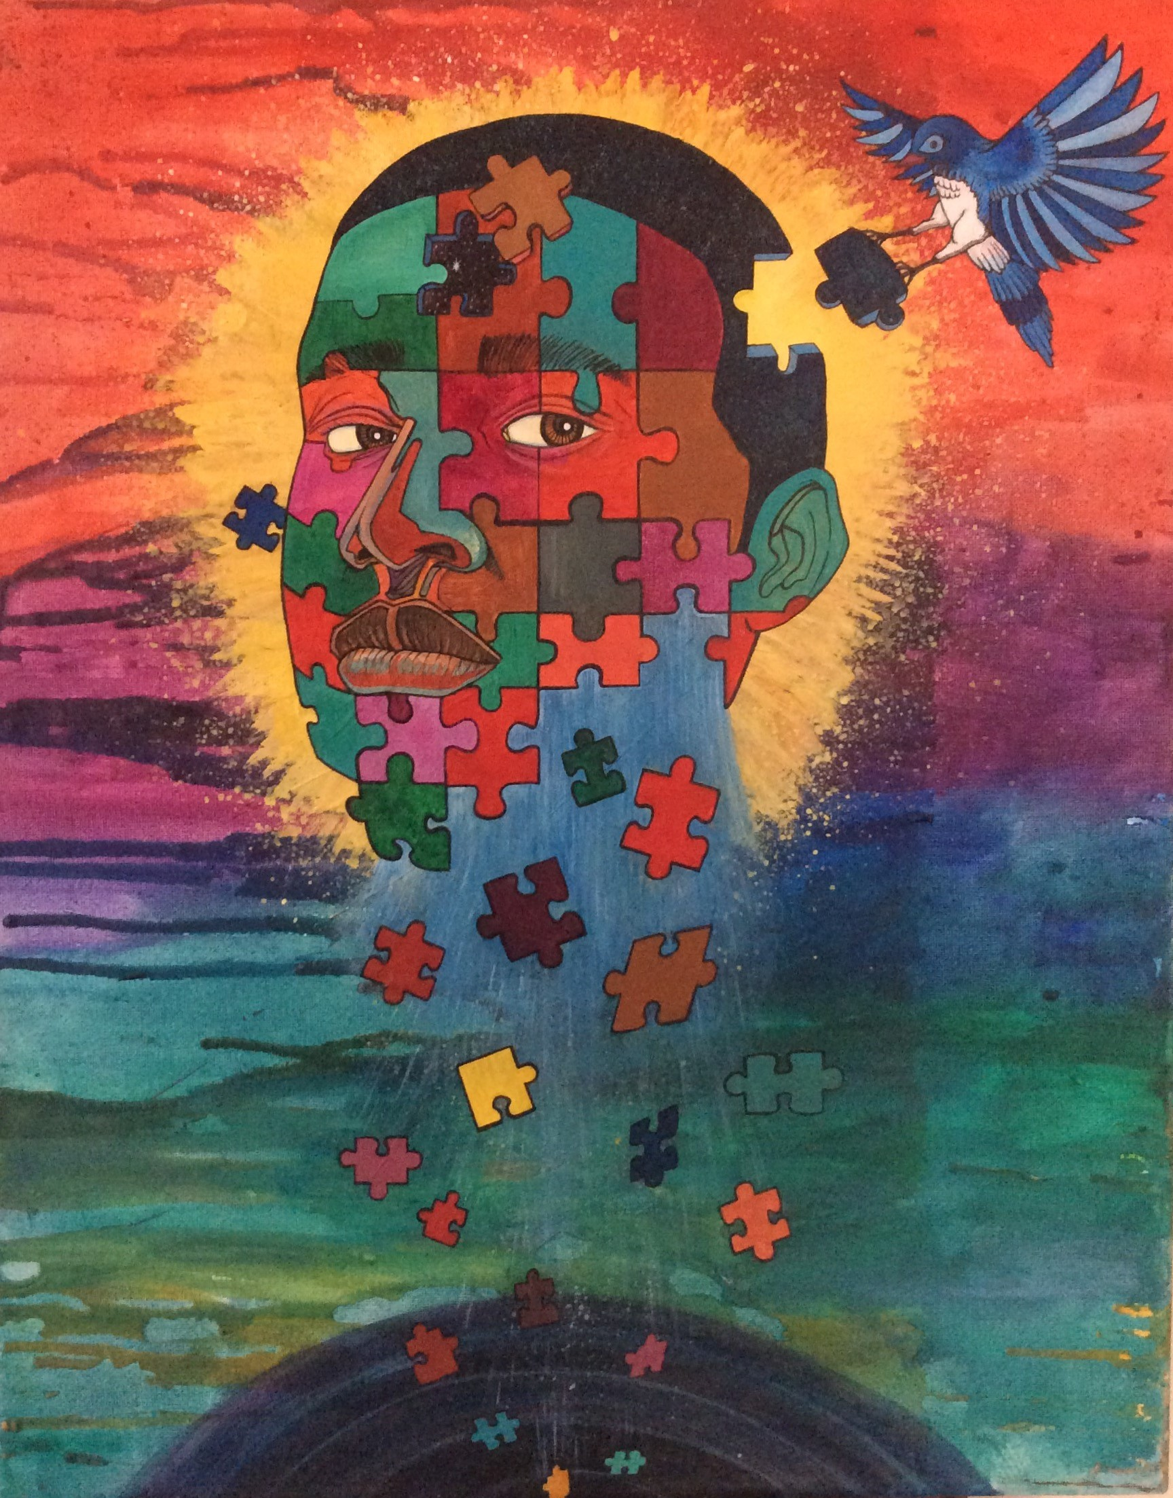
Impact of Financial Stress
Almost ½ skip medical treatments because of cost
⅓ are late on mortgage payments
⅓ overdraw checking accounts
Artist: Sherwin Long,
Peace of Mind

Slide 13
The Promise and Potential of Community Reinvestment Act (CRA) Modernization
Game changer in terms of the focus banks will play in addressing the intersection of poverty and disability.
Could expand for this target population: affordable housing, access to broadband and digital literacy, workforce development and financial capability services.
Highlights:
  Empirical Evidence shows people with disabilities are low- and moderate- income (LMI) and in financial stress.
  Change Is Necessary because, in the absence of and emphasis on disability, banks will not focus on addressing the needs of people with disabilities who will remain in poverty.
  Opportunity exists to revise guidance to financial institutions and educate the disability community.
  NDI has developed a Center to bring to scale sustainable CRA investment, lending and financial services to LMI populations with disabilities.

Slide 14
Significant Overlap between LMI Neighborhoods and Disability – Chicago Example
Low-Moderate Income Designation
Percentage of Population with Disability

Slide 15
Bank Activities
That Demonstrate
Disability Inclusive
Development

Slide 16
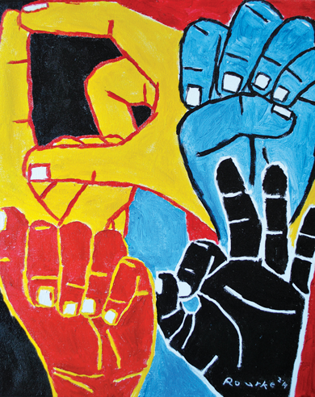
Bank of America: Sign-on
Boost financial empowerment in the Deaf community through a combination of educational workshops and training and ASL videos.
Improve communication access within financial institutions through Deaf awareness.
Increase awareness among BoA staff and communication access to financial services in order to serve Deaf customers more effectively.
3 locations:
Austin, TX
Salt Lake City, UT
State of Maryland
Artist: Nancy Rourke
Culturally Deaf

Slide 17
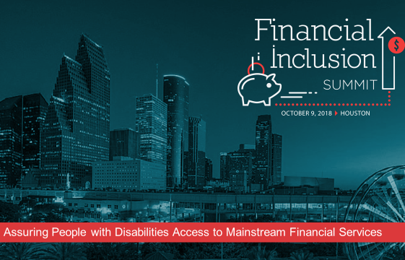
JP Morgan Chase

Slide 18
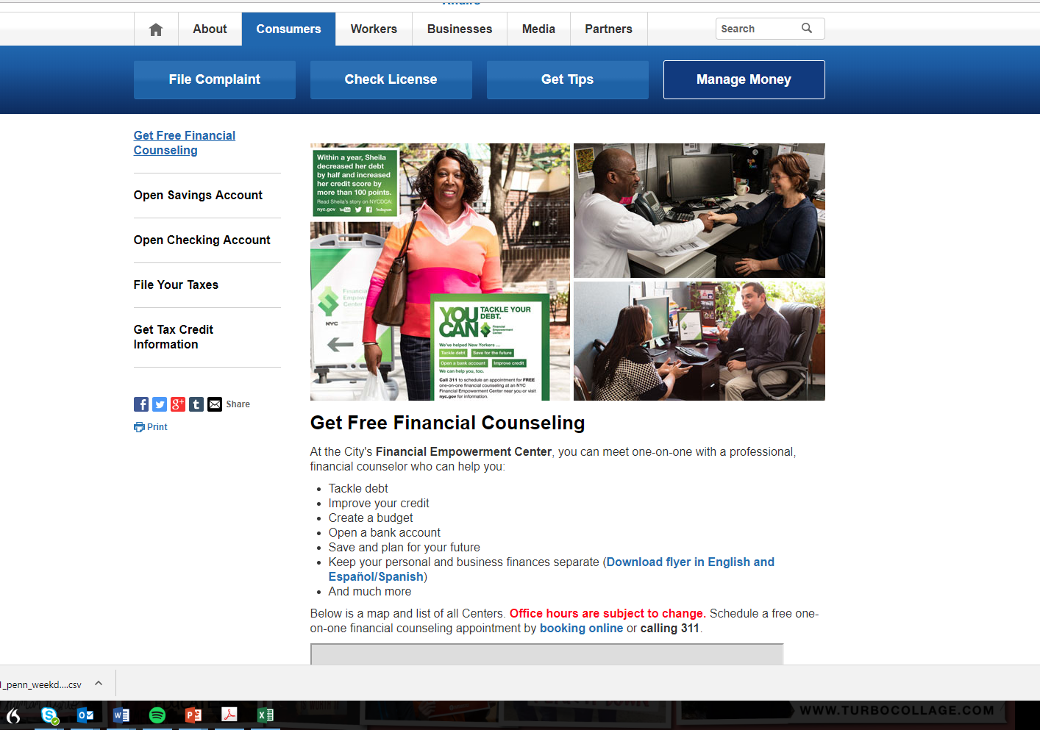
Citi Community Development
Empowered NYC: Financial Empowerment Program for People with disabilities and their families
Free, high-quality, confidential service
One-on-one meetings with certified financial counselors
Covers a broad range of financial issues
Customized to individuals with disabilities and their families
Integrates critical information about disability benefits
Services in the five boroughs of New York City, located at community-based organizations

Slide 19
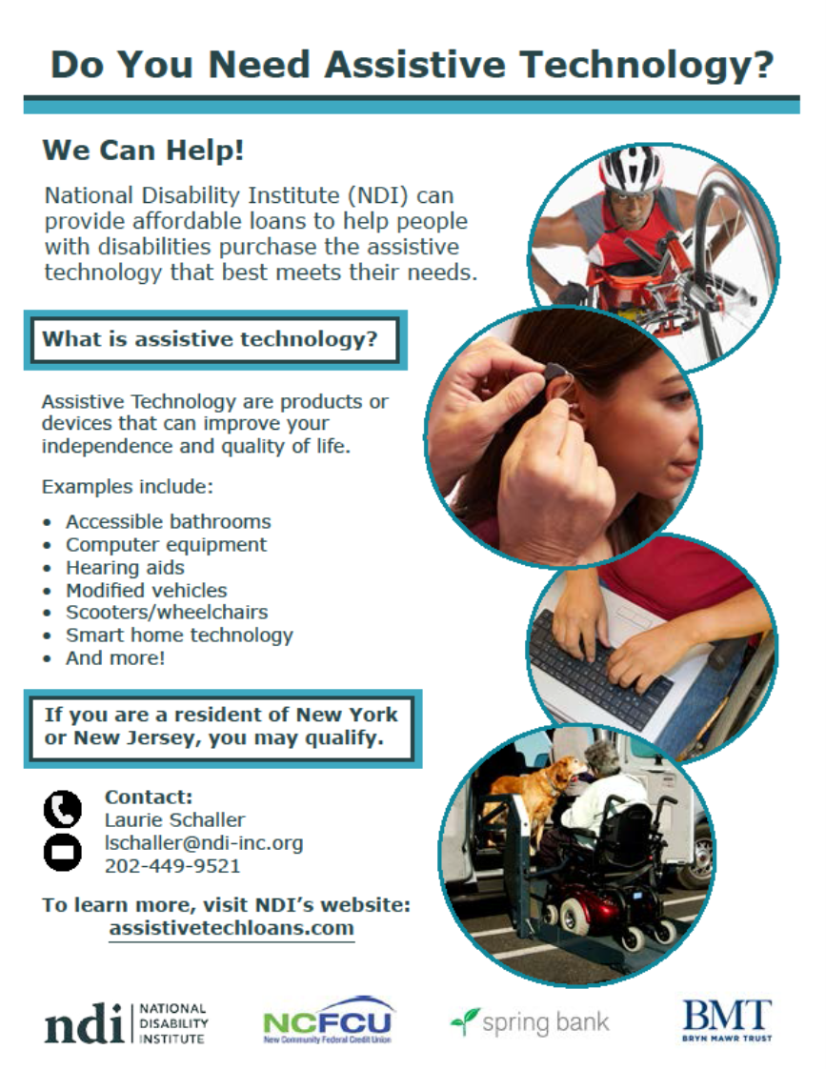
Spring Bank
Issues and services loans for NDI’s Assistive Technology Loan Fund in New York State
Provides an opportunity for borrowers to develop credit and is a viable alternative to predatory lending

Slide 20
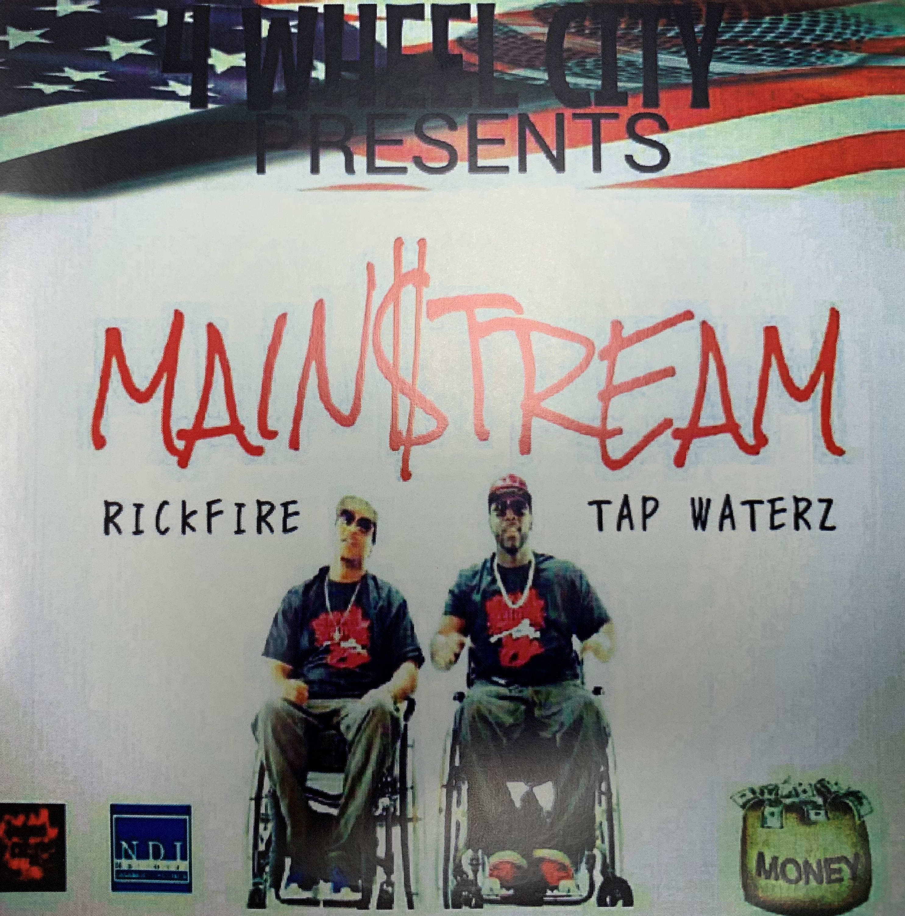

4 Wheel City
Let’s Talk about money
Yo pick a side rich or poor
im trynna get mine you trynna get yours
got little money but I'm trying to get more without breaking the law or breaking your jaw
got a big dreams I wanna see come True
I wanna be mainstream just like you
wanna be world wide just like snoop
thats why I just did a song with snoop
gotta spit this for the people who
been thru the same things I been thru
and just need a deal or loan or two, get back on they feet and help em get thru
Man I'm tired of living check to check
that's why I'm out here trynna invest
in myself and make connects
and show i still got some self respect
so before you doubt hear me out Uncle Sam yeah I'm calling u out
this last day my pockets gon be in a drought its
Enough to make a rolla wanna scream n shout
Lets talk about the Money, lets talk about this Cash.
CHORUS: I can work I can dream I can be so Mainstream/ I can work I can dream I can be so Mainstream/ I can work I can dream I can be so Mainstream

Slide 21
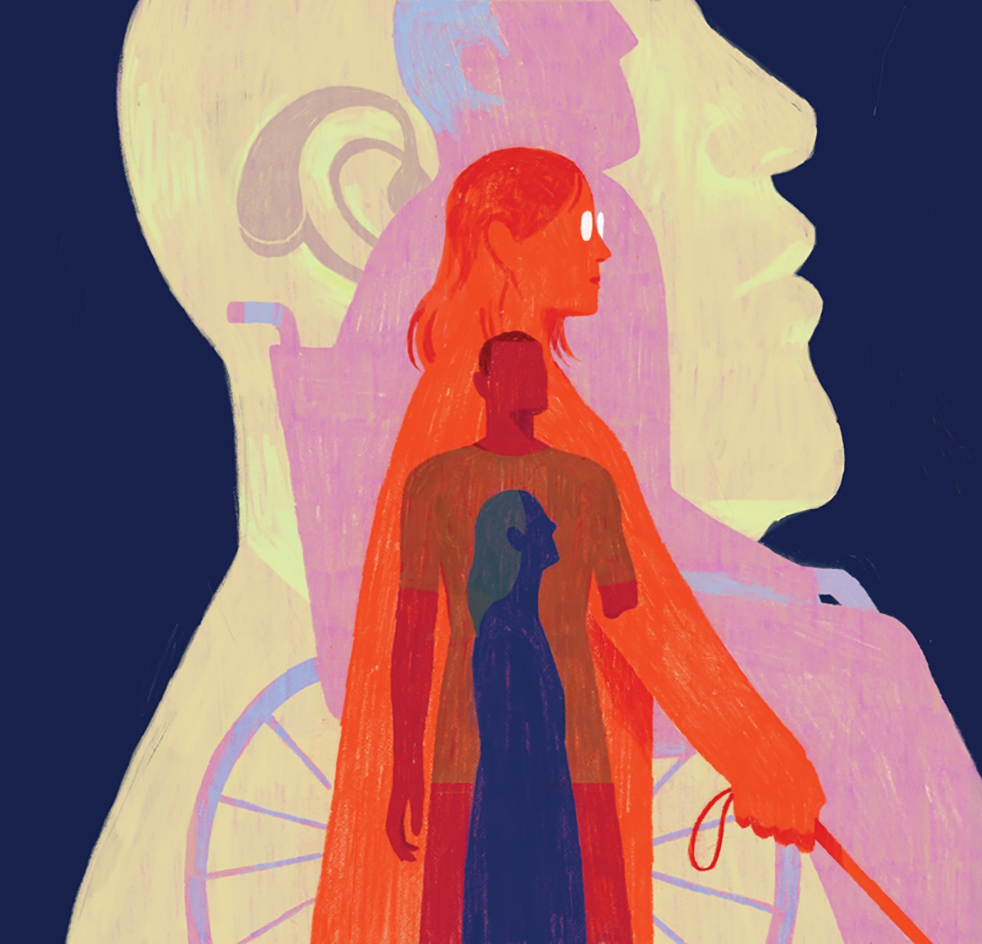
A hand up, not a hand out
More independent through saving and asset building
Artist: Dadu Shin,
Disability Series

Slide 22
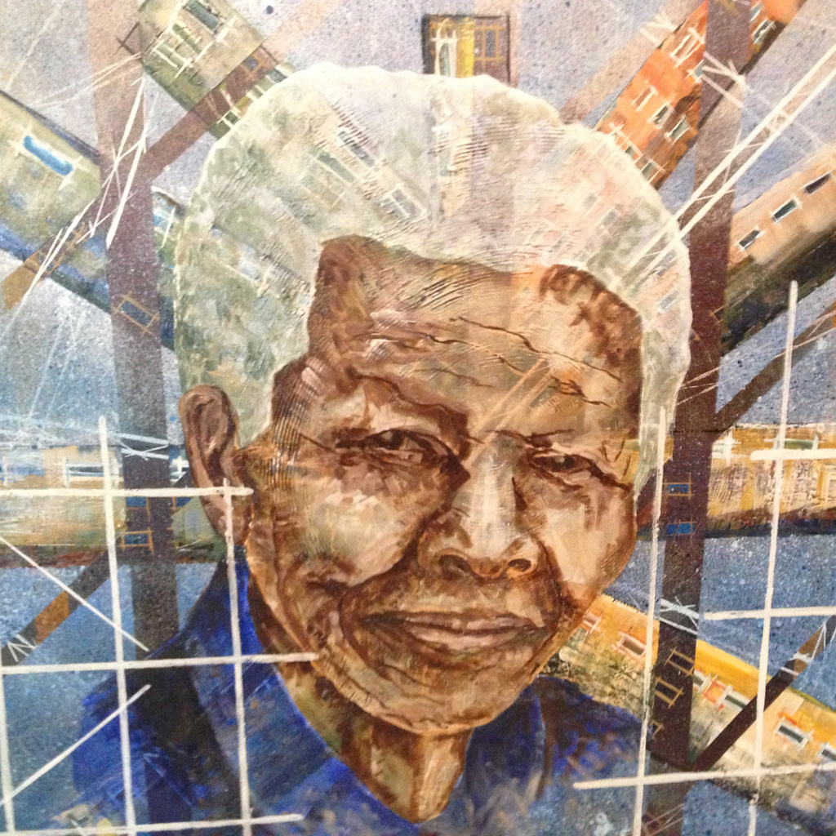
Mandela
“Overcoming poverty is not a gesture of charity.
It is the protection of a fundamental human right,
the right to dignity and a decent life.”
- Nelson Mandela
Artist: Daniel Rankadi Mosako
Mandela

Slide 23
Inaugural Webinar
Introduction and Orientation to the
New Center for Disability-Inclusive Community Development
Join us on July 25! 3:00-4:30 PM ET
https://zoom.us/webinar/register/WN_0a2G2_dSQqi0U0yFUimqBQ
Agenda:
CRA: Understanding the Basics
The Intersectionality of low- and moderate-income populations and neighborhoods with LMI people with disabilities
Orientation to the new Center and future activities
Examples of Inclusive Community Development
Presenters:
Janet Hamer, NDI Board of Directors Chair and Retired Community Development Specialist, Federal Reserve Bank of Atlanta
Tom Stokes, Southeast Community Affairs Manager, Division of Depositor and Consumer Protection, FDIC
Mark Richert, Center Director
Michael Morris, NDI Executive Director
Nanette Goodman, NDI Director of Research

Slide 24
Thank You!
For more information about the new
Center for Disability-Inclusive Community Development, please visit:
www.nationaldisabilityinstitute.org/disability-inclusive-community-development/
For more information about National Disability Institute, please visit:
www.nationaldisabilityinstitute.org
For more information about the ABLE National Resource Center, please visit:
www.ablenrc.org
Michael Morris, Executive Director
mmorris@ndi-inc.org

