Slide 1
Disability Awareness
Training for VITA volunteers
Notes:
As you are going through this training – text in italics is intended as a script for the trainer.
Items not in italics are for the trainers informational purposes.

Slide 2
Agenda
What is disability
Different types of disabilities
People First Language
Tips for Communicating
Service Animals
Policies and Procedures
Site Coordinator Training
Site Accessibility
Notes:
Script: This is an overview of our agenda today (Read slide)

Slide 3
Disability Awareness Training
Provides information that will allow you to interact more effectively with people with disabilities.
Provides basic tips on interacting with persons with disabilities.
Eliminates myths and increases awareness of a growing demographic we serve in VITA Sites.
Notes:
Script: What is the purpose of today’s Disability Awareness Training?
Provides information that will allow you to interact more effectively with people with disabilities.
Provides basic tips on interacting with persons with disabilities.
Eliminates myths and increases awareness of a growing demographic we serve in VITA Sites.
Set the stage: Script – There will be a contest coming up in the next slide – the 1st to tell me how many individuals have a disability and what each (or as many as possible ) what their disabilities are specifically WINS a prize.
Prize can be as simple as candy bar, calculator etc. in order to capture attention of audience

Slide 4
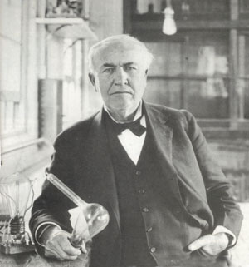
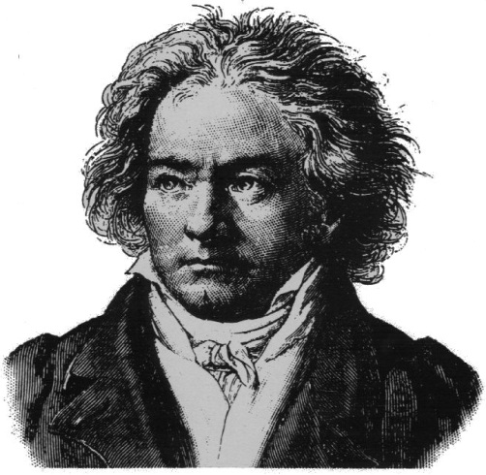
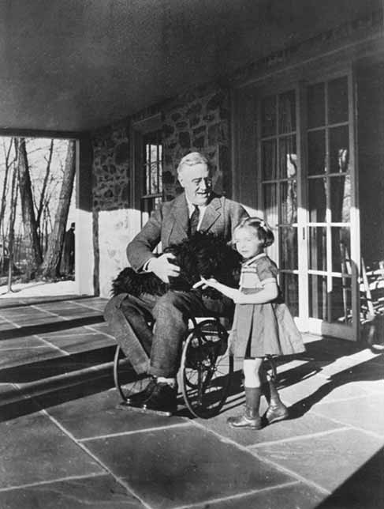
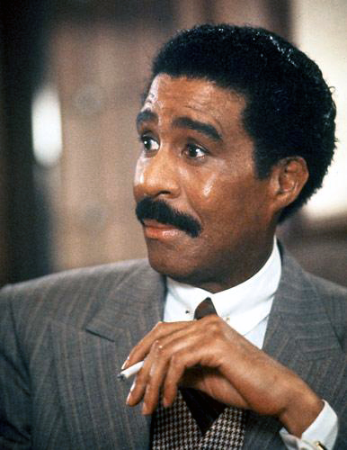
Who has a disability?
Notes:
Script: Begin by reading names of individuals shown on the screen (especially if you have members of the audience who are blind or who have low vision.)
Ask: How many individuals on the screen have a disability and what the disability is for individual(s)?
Person who gets closest to all six correct win.
After game is over Recap
Script:
All six are famous individuals who have accomplished great work and are persons with a disability.
Answers: Whoopi as adult learned she had dyslexia. Thomas Edison into today’s world would have been diagnosed with ADHD as a child and at the age of 13 lost most of his hearing from scarlet fever. Beethoven, began to lose his hearing around his 30s and went completely deaf later in life. President Franklin D. Roosevelt – polio , paralyzed waist down. Richard Pryor was diagnosed with MS. Marlee Matlin, famous actress deaf

Slide 5
What is disability?
The American with Disabilities Act (ADA) Definition of Disability:
An individual with a disability is a person who
Has a physical or mental impairment that substantially limits one or more major life activities
Has a record of such an impairment or
Is regarded as having such an impairment
Notes:
Script: Understanding the ADA’s definition of disability will help you better understand an example of individuals to whom we are referring. The American with Disabilities Act (ADA) Definition of Disability: An individual with a disability is a person who
-Has a physical or mental impairment that substantially limits one or more major life activities
-Has a record of such an impairment or
-Is regarded as having such an impairment
It is important to note there are other definitions of disability for different purposes, this is however the ADA definition

Slide 6
Different Types of Disabilities
Hearing
Mobility
Cognitive
Visual
Speech / Communication
Learning
Mental Health / Emotional
Health Conditions
More in common than not!
Notes:
Script: This slide give us an overall look at different types of disabilities, however it is important to note we all have more in common than not.
*Keep in mind that some disabilities such as mental health/emotional and health conditions (ex: Epilepsy) are considered to be hidden disabilities, but still remain to be protected under the ADA

Slide 7
Something we all have in common
Any one of us could become a part of this demographic at any given moment.
Notes:
Script: There are many different demographics and types of individuals throughout our country. And although we may never know what it is like to be of a different group who is classically referred to as a minority such as, African-American, Latino, Women any one of us at any time could become a person with a disability. Disability crosses all ethnicities, religions, social and financial backgrounds.
The importance of this is to understand that persons with disabilities are PEOPLE first who have more in common with you than NOT and should be treated like everyone else.
We are all individuals with commonalities and differences.

Slide 8
Statistics
In the last 10 minutes, 498 Americans became a person with a disability National Safety Council, Injury Facts 2008 Ed.
58 million Americans with disabilities…..1 in 5 (20% of the population)
20 million families have at least one (1) member with a disability
51% of taxpayers with disabilities earn less than $21,000 a year
Notes:
Script: Disability is much more common than we think or realize and persons with disabilities should be treated no differently than anyone else.
These are some interesting statistics that may help us all relate to persons with disabilities and understand what a large demographic we are actually referring to
Read or highlight statistics from slide

Slide 9
PITY or PEDESTAL?
Go back to the GOLDEN RULE
Treat Others as You would like to be Treated!
NEITHER
Notes:
Script: Pity or Pedestal?
Neither, It is important to remember when it comes to persons with disabilities the answer is NOT to pity and individual or to put them up on a pedestal as though accomplishing every day tasks would not be an ability they could manage – we should go back to the golden rule we all hopefully learned growing up – TREAT OTHERS AS YOU WOULD LIKE TO BE TREATED – treat everyone as equals regardless

Slide 10
Stereotypes
Assumptions that are made about a person or group’s character or attributes, based on a general image of a particular group of people.
Notes:
Script: Read Definition on slide
All too often it is common practice for us to meet people and make assumptions based on our initial impression of an individual which usually includes their physical appearance. Then, we tend to surmise what we believe are their abilities or inabilities based on snap judgments. And unfortunately when people come into contact with individuals with disabilities, especially physical or easily recognizable disabilities, most of the time they have low expectations and assume individuals with disabilities are not capable of higher achievements. It belittles them and minimizes the many abilities they do have, our goal is to train our way of thinking to change so we are seeing an individual for their abilities rather than their disabilities.
It is also extremely important to note that not all disabilities are easily recognizable, a great number of disabilities are often hidden and not readily visible. Persons with disabilities are individuals just like everyone else with their own talents and skill sets capable of great work and accomplishments just like the famous individuals displayed in the previous exercise.

Slide 11
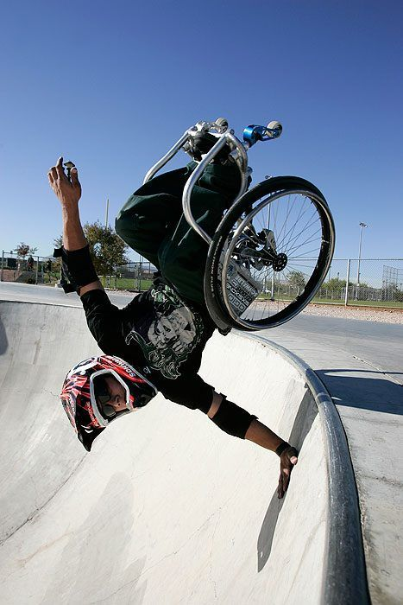
Do not get swept up in Stereotypes
Persons with disabilities are all ages, come from diverse cultures and financial backgrounds.
People with disabilities work
They have families
Not all persons with disabilities are on or receive benefits such as SSI, Medicaid etc.
They have goals and dreams
All people with disabilities do not necessarily want or need assistance
Aaron Fotheringham, Extreme Wheelchair Sportsman
www.aaronfotheringham.com
Notes:
Script: When working with persons with disabilities it is important to not get swept up in stereotypes.
Review the list of common stereotypes debunked above
Script: Picture of interest – This is a picture of Aaron Fotheringham, he is a wheelchair user that does not let his wheelchair get in the way of participating in extreme sports instead he uses his chair to participate in a sport he loves. At the age of 14, Aaron Fotheringham was inducted into the Guinness Book of World Records for doing the first back flip in a wheelchair. He calls his method of wheelchair extreme sports “hardcore sitting”. I encourage you to visit his website at www.aaronfotheringham.com if you are interested in learning more about Aaron.

Slide 12
Other common stereotypes….
People who are blind or have low vision may wear glasses
People who are deaf may have excellent speech and read lips but not all
Not all people that use wheelchairs are completely paralyzed – some may transfer or be able to walk short distances
Delayed or slow speech is not necessarily a sign of a slowed mental process
Persons with learning disabilities can be highly intelligent individuals they simply have a different way of learning
Notes:
Script: Additional common stereotypes
People who are blind or have low vision may wear glasses
People who are deaf may have excellent speech and read lips but not all
Not all people that use wheelchairs are completely paralyzed – some may transfer or be able to walk short distances
Delayed or slow speech is not necessarily a sign of a slowed mental process
Persons with learning disabilities can be highly intelligent individuals they simply have a different way of learning

Slide 13
Tips on Interacting with Persons with Disabilities
Notes:
Script: In the next several slides we will review some specific tips on interacting with persons with disabilities.

Slide 14
People First Language
“People-first” language helps us remember that people are unique individuals and that their abilities or disabilities are only part of who they are.
When speaking about people with disabilities the rule of thumb is to always think about putting the person first.
Notes:
Script: “People-first” language helps us remember that people are unique individuals and that their abilities or disabilities are only part of who they are.
When speaking about people with disabilities the rule of thumb is to always think about putting the person first.

Slide 15
Examples of People First
Positive | Negative
Accessible or Barrier Free (such as parking or entrances, seating, restrooms etc) | Handicapped
Person who is hard of hearing | Partially Deaf, Hearing Impaired
Person who has low vision | Partially Blind, Vision Impaired
Wheelchair User | Wheelchair Bound
People or Person with Disability | Handicapped, the disabled, physically challenged, crippled etc
Person with a developmental/ intellectual disability | Retarded, mentally defective, mongoloid
Born with a disability. | Birth defect
Notes:
Script: Here are some common examples of People first language - One quick trick is to take the “ed” out of your language for example “handicapped” “disabled” etc……. Reiterate when speaking about people with disabilities the rule of thumb is to always think about putting the person first.
Time permitting review some of the positive/negative examples above

Slide 16
# 1 Tip for Communication
Ask FIRST
Notes:
Script: Persons with disabilities are like everyone else, they are People First who often want to be independent and live fulfilling, productive lives just as we all do.
It is wonderful as a society when we want to help one another. It is just important to keep in mind that we all enjoy making our own choices in our lives and people with disabilities are no different.
So, always ASK FIRST and then wait for instructions on how you may assist.
For Example:
If someone in a wheelchair looks like they are struggling to get through a door or maneuver your facility, ASK FIRST before grabbing someone’s chair and beginning to push them.
If someone is blind and using a cane to come into your facility, do not take them by the arm or elbow immediately, ASK FIRST if they would like for you to be their guide.
In the next few slides we will discuss additional tips for persons with different types of disabilities however, in general if you remember to ASK FIRST you should never go wrong.

Slide 17
Tips in General
Offer to shake hands when introduced. People with limited hand use or an artificial limb can usually shake hands and offering the left hand is an acceptable greeting
Treat adults as adults! Address people with disabilities by their first names only when extending that same familiarity to all others.
ASK FIRST - If you offer assistance, (always ask before assisting someone), then wait until the offer is accepted. Then ask the individual with a disability for instructions on how you may assist them.
RELAX. Don’t be embarrassed if you happen to use common expressions such as “see you later” or “Did you hear about this?” that seem to relate to a person’s disability.
Notes:
Read Slide

Slide 18
Tips for Communicating with Individuals who are Blind or have Low Vision
When approaching state clearly who you are, speaking in a normal tone of voice. Do not shout
When conversing in a group, remember to identify yourself and the person to whom you are speaking.
Tell the individual when you are leaving
Do not attempt to lead an individual without first asking; if they choose to do so, allow the person to hold your arm/elbow
Be descriptive and specific when giving directions
For example if steps, mention how many and location such as left or right
If you are offering a seat, either give verbal cues or if acting as a guide gently place the individual’s hand on the back or arm of the chair so that the person can locate their seat.
Notes:
Script: The way we communicate with individuals is important not just the tools we provide them.
Good lighting is extremely important for people with low vision. Locating your VITA services in an area with good lighting can assist in effective communication.
Review additional tips on slide

Slide 19
Tips for Communicating with Individuals who are Deaf or Hard of Hearing
Gain the person’s attention before starting a conversation (i.e. gently wave your hand in their line of vision or tap the person gently on the shoulder or arm)
If the individual uses a sign language interpreter, speak directly to the person, not the interpreter
Know that some people who are deaf speak quite clearly and then others are non-verbal
When speaking with someone who reads lips, look directly at the individual, face the light, speak clearly, in a normal tone of voice and keep your hands away from your face. Avoid smoking or chewing gum.
Notes:
Script: Gaining a person’s attention can be done through simply making eye contact, waving your hand but not directly in their face simply gaining attention through a visual cue
Also, for those who are hard of hearing, consider moving to a quiet/private location with little to no background noise if possible.
When it comes to sign language interpreters it is important to remember an interpreter is there to act simply as that an interpreter of language. The conversation should still be between one’s self and the individual. A sign language interpreter should not act as an advocate or to voice their own opinions they are simply there to interpret conversation only.
When working with individuals who read lips also remember to speak clearly however DO NOT over-exaggerate
Deaf Culture – it is important to note that individuals who are deaf and utilize American sign language (ASL) communicate in a different language. Because ASL is communication by hand gestures and placement of the hands often the sentence structure is communicated differently and are sometimes shorter and to the point without as much description. For example instead of “I go to the store” and individual signing may say through hand movements “Store – I go” So, it is important to remember should an individual come in for services and you end up writing back and forth for initial communication their grammar or vocabulary may be simple and the sentence structure may seem out of order, however this is not necessarily a reflection of their intellectual capabilities it is just a different way of communicating. Also, it is VERY important to remember that just like all of us, persons who are deaf vary in ways in which they were educated and in their communication methods. So, on the other side do not be surprised when an individual who is deaf or hard of hearing has great writing skills and/or is able to orally speak clearly to for example when communicating through lip reading.

Slide 20
Tips for Communicating with Individuals with Limited Mobility
If possible, put yourself at the wheelchair user’s eye level. (especially if speaking to a person for more than a few minutes)
Do not lean on a wheelchair or any other assistive device
Never patronize people who use wheelchairs by patting them on the head or shoulder
Do not assume the individual wants to be pushed – ASK FIRST
When assisting in going up or down a curb, ask if he or she prefers going forward or backward. When pushing a wheelchair and entering an elevator, enter and turn the person around to face the opening doors (not facing a wall)
OFFER assistance if the individual appears to be having difficult opening a door
Do not take mobility aids away from users unless they request it or it is required for safety reasons. If it is necessary let the user know exactly where there equipment is being placed.
Notes:
Read slide

Slide 21
Tips for Communicating with Individuals with Speech Impairments
If you do not understand something the individual says, do not pretend that you do. Ask the individual to repeat what he or she said and then repeat it back.
Be patient and concentrate on what the individual is saying. Take as much time as necessary
Do not speak for the individual or attempt to finish her or his sentences.
If you are having difficulty understanding the individual, consider writing as an alternative means of communicating, but first ask the individual if this is acceptable and only as a last resort
Notes:
Read Slide

Slide 22
Tips for Communicating with Individuals with Intellectual Disabilities
If you are in a public area with many distractions, consider moving to a quiet or private location.
Speak to the individual directly in simple to understand components without being patronizing and in a normal tone of voice.
Be prepared to repeat what you say, orally or in writing.
OFFER assistance completing forms or understanding written instructions and provide extra time for decision-making. Wait for the individual to accept the offer of assistance, do not over-assist or be patronizing.
Notes:
Script: Consider having frequently asked questions in written form available for volunteers to share with individuals utilizing services since many individuals with learning disabilities often or capable of better understanding information through written materials versus oral conversation.
Continue with reading slide

Slide 23
Service Animals
Notes:
Now we are going to briefly review service animals – their rights and responsibilities

Slide 24
TRUE or FALSE?
All service animals must be allowed in all places of business with their owners.
TRUE
All service animals wear official identification such as a vest.
FALSE
It is required for a service animal to have an ID card
FALSE
There is never a reason to evict or deny access to a service animal.
FALSE
Notes:
2nd possible contest first correct answer WINS a prize.
Prize can be as simple as candy bar, etc. in order to capture attention of audience
Ask each question one at a time, click of the mouse will bring about the answer

Slide 25
Definition of a Service Animal
Any dog that is individually trained to perform tasks for people with disabilities. Such as guiding people who are blind, alerting people who are deaf, pulling wheelchairs, alerting and protecting a person who is having a seizure or performing other special tasks.
Service animals are working animals, not pets.
Notes:
Script: The definition of a service animal.
Any dog that is individually trained to perform tasks for people with disabilities. Such as guiding people who are blind, alerting people who are deaf, pulling wheelchairs, alerting and protecting a person who is having a seizure or performing other special tasks.
It is important for everyone to remember Service animals are working animals, not pets.
As an FYI - The new definition of a service animal under the ADA does specify dogs only, however it does allow for the possibility of miniature horses to also act as service animals.

Slide 26
Do……
Do expect that the animal is to be kept under control by the handler at all times. A handler cannot be asked to remove his or her service animal unless – the animal is out of control and the owner does not take effective control (example excessive barking) or – animal poses a direct threat to health or safety of others.
Do allow service animals into all public establishments
May ask the person if they have a disability, if an animal is a service animal or ask how the animal assists the individual but cannot require special ID cards (certification) for the animal or ask specifics about the person’s disability.
Notes:
ScriptThe “Do’s” regarding service animals
Do expect that the animal is to be kept under control by the handler at all times. A handler cannot be asked to remove his or her service animal unless – the animal is out of control and the owner does not take effective control (example excessive barking) or – animal poses a direct threat to health or safety of others.
Do allow service animals into all public establishments
May ask the person if they have a disability, if an animal is a service animal or ask how the animal assists the individual but cannot require special ID cards (certification) for the animal or ask specifics about the person’s disability

Slide 27
DON’T…….
Don’t ask the person what their disability is
Don’t ask the person to demonstrate the animal’s tasks
Don’t ask for “proof” of disability or training.
Don’t pet or talk to the animal without asking the owner first, because it may distract the animal or harm the individual
Don’t feed the animal, many are on strict diets
Don’t assume the animal will bite, service animals are selected for proper temperament and have been through many hours of training and socialization
Don’t assume the individual is blind, many individuals have “invisible” disabilities such as epilepsy, heart conditions, etc.
Don’t charge extra fees, isolate from other patrons or treat them less favorably.
Don’t think you are required to provide care or food for a service animal or provide special location to relieve itself (Example cannot ask or expect you to walk their dog outside)
Notes:
Script: And the “Don’ts” regarding service animals.
Don’t ask the person what their disability is
Don’t ask the person to demonstrate the animal’s tasks
Don’t ask for “proof” of disability or training.
Don’t pet or talk to the animal without asking the owner first, because it may distract the animal or harm the individual
Don’t feed the animal, many are on strict diets
Don’t assume the animal will bite, service animals are selected for proper temperament and have been through many hours of training and socialization
Don’t assume the individual is blind, many individuals have “invisible” disabilities such as epilepsy, heart conditions, etc.
Don’t charge extra fees, isolate from other patrons or treat them less favorably.
Don’t think you are required to provide care or food for a service animal or provide special location to relieve itself (Example cannot ask or expect you to walk their dog outside)

Slide 28
Policies and Procedures
What are the policies & procedures for serving
people with disabilities at your VITA site?
Examples:
How do you process an accommodation request from a customer with a disability?
What are the site’s accessible features and customer service practices?
Notes:
Policies and Procedures can greatly impact accessibility for people with disabilities at VITA sites. It is important your volunteers know the answer to the following:
What is the procedure for handling an accommodation request from a customer with a disability? - who do they go to – site coordinator, if they aren’t available who else may they call? Insert your policy/procedure here
Do workers know who to contact if they receive a request for an accommodation such as request for sign language interpreter, materials in large font, etc. Insert your policy/procedure here
Make sure all VITA workers been informed about the VITA site’s accessible features and accessible customer service practices Insert your policy/procedure here
(For example: Your site may have an accessible entrance or restroom, a separate area available to speak quietly or perhaps some other piece of equipment for customers with disabilities to use, but VITA volunteers may not know that these resources exist.)

Slide 29
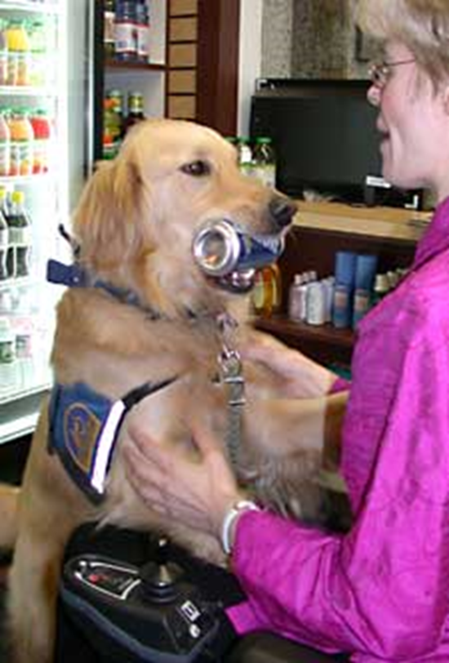
Reasonable modifications are acceptable
Examples:
Service Animals
Food and Drink
Extended Appointment Time
Alternate Signature
Notes:
Policies and Procedures should also allow for Reasonable Modifications of services and practices to accommodate people with disabilities
Do your volunteers know that it is sometimes OK to bend the rules when it comes to making reasonable modifications for persons with disabilities so they may actively and effectively participate in services.
Volunteers may turn away individuals simply because they feel they are unable to make allowances or “bend the rules”
Some examples of reasonable modifications may include:
Services Animals: You may not allow pets in your facility but the Americans with Disabilities Act requires you to allow service animals
Food and Drink may be prohibited at your site, but a person with diabetes may need to bring a snack with them to their VITA appointment
Extended Appointment time: A person with a disability that affects their communication may need an extended appointment time
Alternate Signature: A person with physical or intellectual disability may need to provide their signature in an alternate way such as signing with an “X”, printing their name or using a stamp.

Slide 30
Tips on Site Accessibility
Site Accessibility is everyone’s mission!
In order to ensure continued accessibility it is important everyone is aware of common barriers to avoid on a day to day basis.
Notes:
Script: Once you have established accessibility at your site it is important that everyone remains vigilant in ensuring accessibility is maintained.
The next several slides will give specific tips and areas everyone can look for to ensure accessibility is maintained.
The next several slides are vital for Site Coordinators.

Slide 31
Auxiliary Aids & Services
“Auxiliary aids and services” are devices or services that enable effective communication for people with disabilities.
Notes:
Script: Auxiliary aids & are services are vital for effective communication
Auxiliary aids are any devices or service that enable effective communication for people with disabilities.
It is important that everyone understands there are different types of effective communication available and ensure they have a designated staff name and number to contact with questions on availability and means of acquiring resources. Insert your policy/procedure or contact here
Examples of Auxiliary Aids & Services
Instructions and other information in written format
Exchange of written notes
Typing on computer
Text messaging
Assistive listening devices
Qualified interpreters
Video interpreting services
TTY and/or Relay Service
Large print materials (18 pt. font or larger)
Braille materials
Audio recordings
Materials in electronic format
Reading written information aloud to customer
Providing assistance to complete forms

Slide 32
Effective Communication
When a person with a disability requests an auxiliary aid or service:
Consult with the individual about their choice of aid or service.
Businesses cannot charge the person for the communication aids or services provided.
Notes:
Script: When a person with a disability requests an auxiliary aid or service:
Consult with the individual about their choice of aid or service. There may be more than one option that will work for both of you. The individual is going to know what works best for them.
Businesses cannot charge the person for the communication aids or services provided.
As you may notice the pictures here are samples of VITA spelled out in American Sign Language
Ensure your volunteers know who on staff to contact when an individual is requesting an accommodation Insert your policy/procedure or contact here

Slide 33
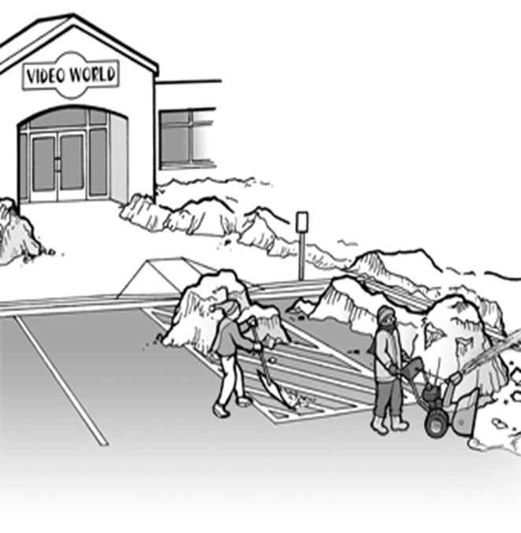
Accessible Parking
You may have accessible parking available however are your access lanes and curb cuts clear of possible debris and other barriers
Notes:
Script: Parking – Review the parking at your site prior to opening and check for the answers to the following
Do you have accessible parking available? You should have accessible parking to include access aisles and curb cuts for physical accessibility.
Once you have verified parking is available it is important to keep in mind….
Many facilities have accessible parking spaces, but sometimes the access aisles, including the curb cuts, are blocked by debris such as snow, ice, leaves, even other cars parking in the access aisles and even sometimes tent signs chairs etc.
Let volunteers know who to notify should they notice these types of barriers (for example site coordinator? And site coordinators should know who to contact to have barriers removed.) Insert your policy/procedure or contact here

Slide 34
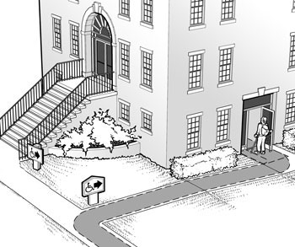
Facility Access: Building Entrance
If there are stairs at the main entrance…
Where is the ramp or lift, or other alternative accessible entrance?
Where are the signs indicating the location of the nearest accessible entrance?
Notes:
Script: The entrance to the building is very important – if individuals can’t access the building they cannot access services
Insert your policy/procedure here and ensure site coordinators/volunteers know the answers to the following for their site
Is there a route of travel to the building entrance that does not require the use of steps or stairs? If there are stairs at the main entrance, is there also a ramp or lift, or is there an alternative accessible entrance?
If there is an alternative route is everyone aware of the location. And if there is a lift, does everyone know how to use the lift? If the lift or elevator becomes inoperable be sure volunteers know who to contact to make them aware of the problem.
Do all inaccessible entrances have signs indicating the location of the nearest accessible entrance?
In older buildings, the main entrance may only have steps. Often there is an alternate accessible entrance, but without a sign it is hard to find, volunteers need to be aware of the importance of these signs and help to ensure they are not covered up or missing.
Finally, even though we hope all sites are accessible should this not be the case and there is no accessible front entrance or alternative route was is the site’s plan to serve persons with disabilities who are unable to enter the site. Ensure volunteers know the next closest accessible VITA site.

Slide 35
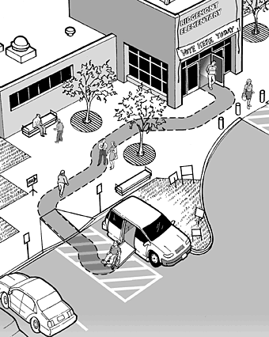
Facility Access: Accessible Route
Is the route of travel stable, firm and slip-resistant?
Is the route at least 36 inches wide?
Notes:
Accessible Route:
Is the route of travel stable, firm and slip-resistant? As an overall safety issue ensure everyone is aware of how important is to keep floors dry and slip-resistant especially during inclement weather such as rain or snow
Is the route at least 36 inches wide? Once a an accessible path of travel is established make sure volunteers understand the importance of keeping a path of travel open and not cluttered by signs, tables , other barriers etc.
Examples of barriers on the accessible routes to building include:
Part of the walkway is gravel
Trash cans , signage, tables and chairs placed in the 36 inch wide pathway block the accessible route

Slide 36
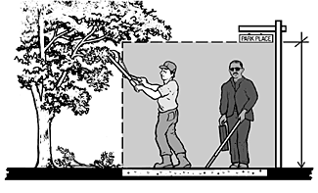
Facility Access: Accessible Route
Can all objects protruding into the accessible route be detected by a person with a visual disability using a cane?
Notes:
Script: Again is there an accessible route? - if individuals can’t gain access they cannot access services
Insert your policy/procedure here and ensure site coordinators/volunteers know the answers to the following for their site
Accessible Route Can all objects protruding into the accessible route be detected by a person with a visual disability using a cane?
Examples of barriers that protrude into the accessible path of travel may include:
low hanging limbs
temporary signs
low hanging outdoor lights

Slide 37
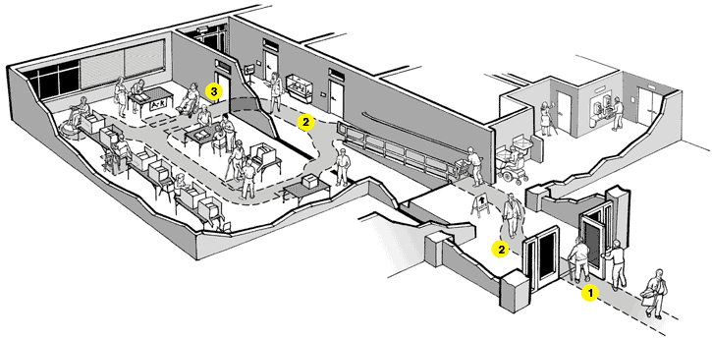
Access to VITA Services
Are VITA services located on an accessible path of travel that is at least 36 inches wide?
Notes:
Script: A continued theme - Accessible Path of travel
Once a customer with a disability enters your building there should be at least one accessible path of travel to the VITA services. This accessible path of travel should be at least 36 inches wide and not require the use steps or stairs.
Again Once a an accessible path of travel is established make sure volunteers understand the importance of keeping a path of travel open and not cluttered by signs, tables , other barriers etc.

Slide 38
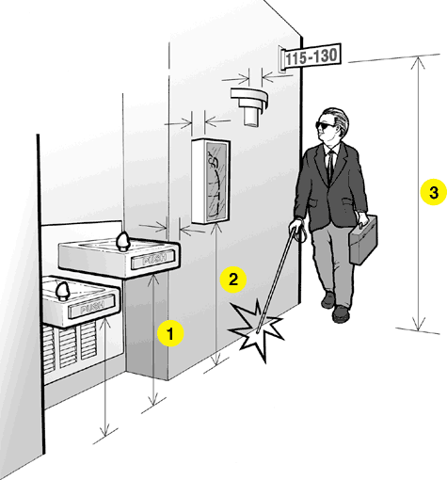
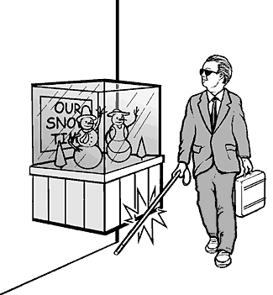
Access to VITA Services
In circulation paths, are all obstacles cane-detectable (located within 27 inches of the floor or higher than 80 inches, or protruding less than 4 inches from the wall)?
Notes:
Accessible Path of Travel
In circulation paths, are all obstacles cane-detectable?
A protruding object is not an obstacle for a person with a visual disability using a cane if:
The object is located within 27 inches from the floor (this can be detected by their cane)
The object is located higher that 80 inches from the floor
The object is less than 4 inches from the wall
Maintenance of a buildings accessibility features is key. Keeping plants trimmed back, making sure that trash cans and furniture are not placed in the accessible path of travel are examples of good maintenance.
In summary, good facility access really benefits everyone. It allows the person with a disability and older adults to easily travel from park lot or drop off area to were the actual VITA services are being provided inside your building. Parents with small children & baby strollers, delivery workers, staff carrying packages also benefit from good accessible design and it makes your facility safer for everyone.

Slide 39
Wrap Up
ASK FIRST
Use Common Sense
The Golden Rule
Be Courteous
Don’t assume
Notes:
Script: Overall, if you go by these simple tasks you can’t go wrong.

Slide 40
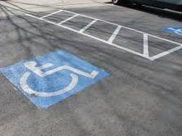
Questions?
Notes:
Question and answer here

Slide 41
Where to Get More Information
National Disability Institute
1667 K Street, NW - Suite 640
Washington, DC 20006
Voice: 202.296.2040
Email: info@ndi-inc.org
Website: www.realeconomicimpact.org
Notes:
Suggest you add your information here including established contact for questions regarding accommodation requests, policies etc.

