Slide 1
Module 2:
Financial Capability and
Access to Financial Services
2023

Slide 2
Welcome & Housekeeping
Introductions
Did everyone sign in?
PRE-Test Evaluation

Slide 3
Agenda
Define financial capability and financial education
Helpful information to select the best financial services
Review the basics of deposit and loan accounts
Defining prepaid cards and individual rights under the law
What is ChexSystems?

Slide 4
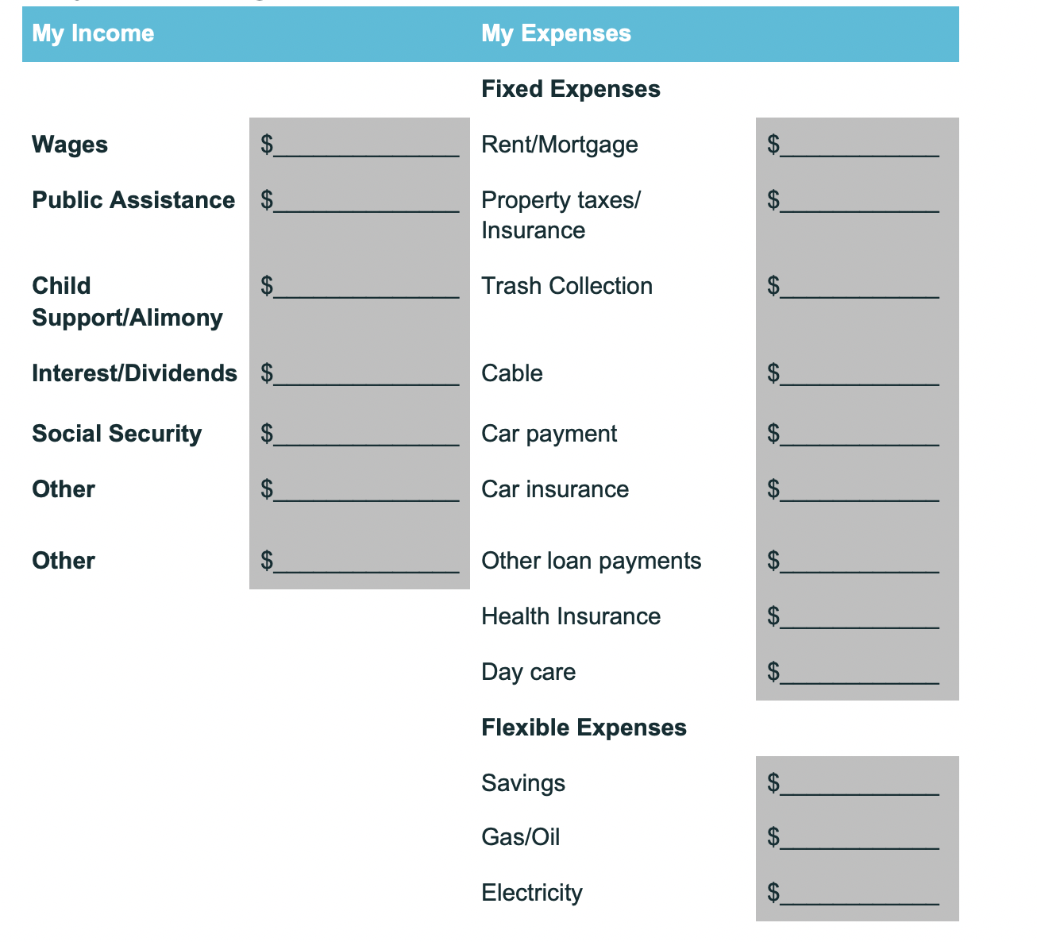
Homework Review
Monthly Spending Plan

Slide 5

Financial Services
What different types of financial services do you need?
  Checking Account
  Savings Account
  Credit Cards
  Money Orders
  Prepaid Cards
  ABLE Account
Tell us what you use and why
This Photo by Unknown Author is licensed under CC BY

Slide 6
Activity
Now, let’s look at our own individual situation.
Let’s go over the Rate Your Financial Behavior and, this time, keep your answers to yourself. You can think about your answers as we review the information on financial capability.

Slide 7
What Do We Mean by Financial Capability?
Financial capability is defined as a set of consumer behaviors that lead to measurable improvements in an individual’s financial wellness.
Ways financial capability may be measured for people with disabilities
  Set and achieve one or more financial health goal(s)
  Access and manage public benefit and work support programs
  Manage monthly expenses and debt
  Manage credit appropriately
  Select and manage financial products and services
  Plan and save money now and for your future
  Increase financial knowledge and make informed decisions regarding one’s financial wellness

Slide 8
Financial Capability
The Consumer Financial Protection Bureau (CFPB) is the government agency responsible for consumer protection in the financial sector.
CFPB defines financial well-being as having four parts:
  Feeling in control of your finances
  The capacity to absorb a financial shock
  On track to meet goals
  Flexibility to make choices

Slide 9
How Can You Avoid Being Financially Vulnerable?
Become educated in the complex financial services marketplace.
Set goals for yourself and work towards those goals.
Practice each month by establishing records and developing systems to manage your money habits and finances.

Slide 10
What Do You Need to Know About Financial Services?
Who offers financial services
What financial services are available
Where they are offered
How to compare and choose what you need

Slide 11
Who Offers Financial Services?
Banks
Credit Unions
Wal-Mart
Convenience Stores
U.S. Postal Service
Prepaid Cards—Grocery Stores, Retail Stores
Internet

Slide 12
Basics of Financial Services
For our time today, we will focus on:
  Banks
  Credit Unions
  ABLE Accounts

Slide 13
How Do Consumers Choose?
Friendliness, trustworthiness
Ease/convenience
Too many choices or limited choices
Default options

Slide 14
Deposit Accounts
Accounts (such as checking, savings or money markets) where you deposit your money and can use the money without restriction or access to it later are what banks and credit unions call deposit accounts.

Slide 15
Choosing a Deposit Account
How will I use it? (ATM networks, direct deposit or checks? Savings?)
Do I need branches?
Is it insured? (FDIC and NCUA)
Am I (or my family) a member of a group that gives me access—credit unions, professional associations, military, AAA, employers, etc.
Do I need overdraft protection?

Slide 16
Factoring Costs When Choosing Accounts
How you will use the account determines how much it will “cost”:
  Transaction fees, monthly maintenance fees, up to X transactions/month, overdraft fees, returned item fees, minimum balances, ATM fees, withdrawal fees, deposit fees
  Do you have other accounts? (savings or loans?)
  Interest bearing yields?

Slide 17
FDIC Model Safe Account Template
The FDIC Model Safe Accounts Template provides insured institutions with guidelines for offering cost-effective transactional and savings accounts that are safe and affordable for consumers.
The electronic deposit accounts are designed to meet the needs of underserved consumers.
The accounts reflect the following guiding principles:
  Transparent rates and fees that are reasonable and proportional to costs
  Access to banking services that feature FDIC insurance
  Protections afforded by applicable federal and state consumer protection laws, regulations and guidelines
fdic.gov/consumers/template/template.pdf

Slide 18
Savings Accounts
Savings accounts can be used to separate your financial goals from your ongoing monthly bills. Savings goals might include:
  Emergency/Contingency Savings
  A specific goal: Gifts, tuition, car purchase, homeownership down payment
  Longer-term goals: tuition expenses, a car or down payment on a home
Other differences between checking accounts and savings accounts:
  Savings accounts are interest-bearing (although some credit union checking accounts are as well)
  Number of transactions limited
  Generally, no check writing unless the money goes into another account
  Debit cards may or may not be offered

Slide 19
Protected Savings Options
Some individuals have a need for a protected savings account in order to maintain countable resources of less than $2,000 for an individual (or $3,000 for a couple). There are several options:
  ABLE (Achieving a Better Life Experience) Account
  FSS (Family Self-Sufficiency)
  IDA (Individual Development Account)
  PASS (Plan to Achieve Self-Support)
  Homebuyer Club
  Special Needs or Pooled Trust
  More in-depth detail on these options is covered in other modules of the curriculum.

Slide 20
Prepaid Cards
Gift cards and prepaid cards differ from credit and debit cards in important ways.
  They may not be insured, or have a bank account behind them
  They may not be protected if lost or stolen
  Fees may be predatory (deposits $15.00 each, transfer money to other countries, $20.00)
  Consumers may be influenced by marketing—Kardashian cards, other NetSpend cards. ($ to reload, other fees)
  No credit-building
  Forced arbitration

Slide 21
What Is ChexSystem?
The ChexSystems, Inc. network is comprised of member financial institutions that regularly contribute information on closed checking and savings accounts.
ChexSystems shares this information among its member institutions to help them assess the risk of opening new accounts.
ChexSystems does not make account opening decisions for its members. Account opening decisions are made by the member institutions based on their internal policies.

Slide 22
Consumer Loans - Revolving (Slide 1 of 3)
Allows you to buy goods or services now and pay back over time, with flexibility to pay a little or the entire debt. These are “revolving” debts.
  Examples: Visa, Mastercard, Discover
  “Store Credit Lines/retail credit cards” may be revolving
  Have a credit limit
  Have minimum payments
  Have annual percentage rates/fees/terms
  Plastic Debit Cards and Stored Value/Prepaid Cards do not enable credit building

Slide 23
Consumer Loans - Revolving (Slide 2 of 3)
  They may have other benefits to the consumer, such as points or free life insurance coverage
  Allow you to build credit
  All “plastic cards” are not credit cards. “Store brand charge cards” have similar features and also allow credit-building
  For FICO scores, keep outstanding balance below 30% of the credit limit in order to raise your score. We will talk more about this in Module 4: Credit Matters
For credit cards, banks and credit unions provide information on their card products at: bankrate.com.

Slide 24
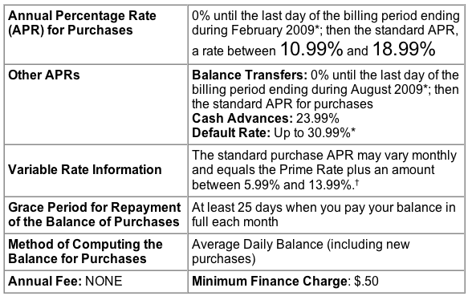
Consumer Loans - Revolving (Slide 3 of 3)
For credit cards, there is a standard disclosure known as the Schumer Box:
There may be other fees to ask about: late payment fees, cash advance fees and balance transfer fees.

Slide 25
Consumer Loans - Installment (Slide 1 of 3)
Allows you to purchase goods and services now and pay back over a fixed number of installments, thus “installment debt”.
  Examples: Student loans - 10 years, car loans
  Have the same payment for the life of the loan
  Have a percentage rate, fees, terms
  May have other benefits
  Credit building: longer-term installment debt, paid on time will raise your score

Slide 26
Consumer Loans - Installment (Slide 2 of 3)
Store installment loans
  Often very high interest rate and fees; but 90 days same as cash are often a good deal—be careful of what happens if you don’t pay it off within 90 days
  May add credit life insurance, disability insurance and the costs must be disclosed
Payday loans and car title loans

Slide 27
Consumer Loans - Installment (Slide 3 of 3)
Regulation Z: Truth in Lending requires disclosures so that the consumer can determine:
ANNUAL PERCENTAGE RATE
  The cost of your credit as a yearly rate__________%
FINANCE CHARGE
  The dollar amount the credit will cost you $_________
AMOUNT FINANCED
  Amount of credit provided to you or on your behalf $_________
TOTAL OF PAYMENTS
  The amount you will have paid when all payments are made on time $_______
TOTAL SALE PRICE
  The total cost of your purchase on credit including your down payment of $_______

Slide 28
Homework Assignment
Set a goal for savings and sign up to be an Illinois Saver by visiting: americasaves.org/connect-to-a-campaign/?state=illinois
Ask your bank or credit union if they have a credit-building product you are eligible to use.
  If you don’t currently have a bank account, you are encouraged to visit a bank and complete the “My Trip to the Bank” handout.

Slide 29

Questions

Slide 30
Evaluation and Closing
Don’t Forget!
Complete and turn in your evaluation and post-test.
Congratulations on completing your first steps towards improving YOUR financial wellness.
Thank YOU!

