Slide 1
Introduction

Slide 2
Welcome & Housekeeping
Introduction
Sign-in
Notes:
Michael

Slide 3
National Disability Institute (NDI)
This training series was created by National Disability Institute (NDI) with support from Illinois Council on Developmental Disabilities.
I have attended a training series by National Disability Institute on Financial Wellness and am not a representative of National Disability Institute.
To learn more about National Disability Institute, go to:
NationalDisabilityInstitute.org
Notes:
Michael

Slide 4
Agenda
Introduction activity
Set the framework for Financial Wellness – What is Economic Self-Sufficiency?
Overview of training topics/modules
What do we know about people with disabilities and poverty?
Overview of National Disability Institute’s Five Key Strategies to financial wellness.
American Dream Exercise
Questions and Closing
Notes:
Michael

Slide 5
Introductions
Name
Where you work/go to school
What you like to do
Notes:
Michael

Slide 6
It’s the Law! The Americans with Disabilities Act (ADA) of 1990
The Financial Wellness for People with Disabilities training program has been developed by National Disability Institute to promote financial wellness and foster greater economic self-sufficiency for persons with disabilities.
The ADA states that our nation’s goals are to “assure equality of opportunity, full participation, independent living, and economic self-sufficiency” for individuals with disabilities. Key to achieving these goals is the ability of people with disabilities to become financially stable — generally only possible through employment, high-quality and affordable health care and ready access to financial information and services. Financial Capability Of Adults With Disabilities
Notes:
The continuing existence of unfair and unnecessary discrimination and prejudice denies people with disabilities the opportunity to compete on an equal basis and to pursue those opportunities for which our free society is justifiably famous, and costs the United States billions of dollars in unnecessary expenses resulting from dependency and non-productivity.
42 U.S.C. § 1201(a)(9) (2005)

Slide 7
Overview of Training
Module 1: Money
Module 2: Financial Capability and Access to Financial Services
Module 3: Earned Income Tax Credit: Free Tax Preparation Assistance
Module 4: Credit Matters
Module 5: Housing Choices and Supports
Module 6: Social Security Work Supports
Module 7: Self-Employment and Public Benefit Work Supports
Module 8: Protecting Your Identity
Module 9: Getting ABLE Ready
Module 10: Guardianship Rights: Who is responsible for What?
This training was developed using the Self-Determination – Building Blocks

Slide 8
Self-Determination – Building Blocks
A person has the FREEDOM to dream, to make his or her own decisions and to plan his or her own life.
A person has the AUTHORITY to control how money is spent for his or her supports.
A person has the SUPPORT needed from friends, family and other people the person chooses.
A person takes RESPONSIBILITY to do what he or she says he or she will do.
CONFIRMATION – The recognition that individuals themselves drive the design of their long-term services and supports.
It is important that we keep these building blocks in mind, as they will help provide additional direction as we work toward becoming financially fit. They will help in making informed decisions about saving money and building assets for a better economic future, a better quality of life and more independence.

Slide 9
Financial Wellness
What is it?
Why is it important?

Slide 10
Disability and Poverty
People with disabilities are more likely to be unemployed and to live in poverty than any other single demographic group in the United States today.
Public benefit programs for people with disabilities, especially Supplemental Security Income (SSI), are not aimed at increasing assets and independence for people with disabilities.
More so than any other population on a fixed income, services and policies do not hold the expectation of economic self-sufficiency.

Slide 11
Disability and Poverty continued
In 2022, it is estimated that 24.7 percent of non-institutionalized persons aged 21 to 64 years with a disability in the United States were living below the poverty line. The poverty rate for people without a disability was 9.6%.
Enduring poverty and lack of economic empowerment diminishes choices and quality of life within communities and singularly diminishes freedom, opportunity and self-determination.

Slide 12
Illinois Disability Statistics
12% Of overall Illinois population report a disability;
9.8% Of households report having an adult member (age 21-64) with a disability;
46% Of adults are employed compared to 82% of those without a disability;
Average annual income is $52,000 for households with a disability and $62,500 with no disability;
25% Of working-age people with a disability live in poverty;
16% Receive Supplemental Security Income.
Cornell University: DisabilityStatistics.org

Slide 13
Asset Poverty Varies Significantly
33% Of all American households have no assets or are in debt.
54% Of Hispanic households have a similar status.
60% Of African American households have no net assets.
80% of persons with disabilities have no net assets.
The continuing existence of unfair and unnecessary discrimination and prejudice denies people with disabilities the opportunity to compete on an equal basis and to pursue those opportunities for which our free society is justifiably famous, costing the United States billions of dollars in unnecessary expenses resulting from dependency and non-productivity. (42 USC 1201: Authorization of appropriations)
Notes:
The continuing existence of unfair and unnecessary discrimination and prejudice denies people with disabilities the opportunity to compete on an equal basis and to pursue those opportunities for which our free society is justifiably famous, and costs the United States billions of dollars in unnecessary expenses resulting from dependency and non-productivity.
42 U.S.C. § 1201(a)(9) (2005)

Slide 14
Activity
What does Financial Wellness mean to you?
What might prevent us from achieving financial wellness?

Slide 15
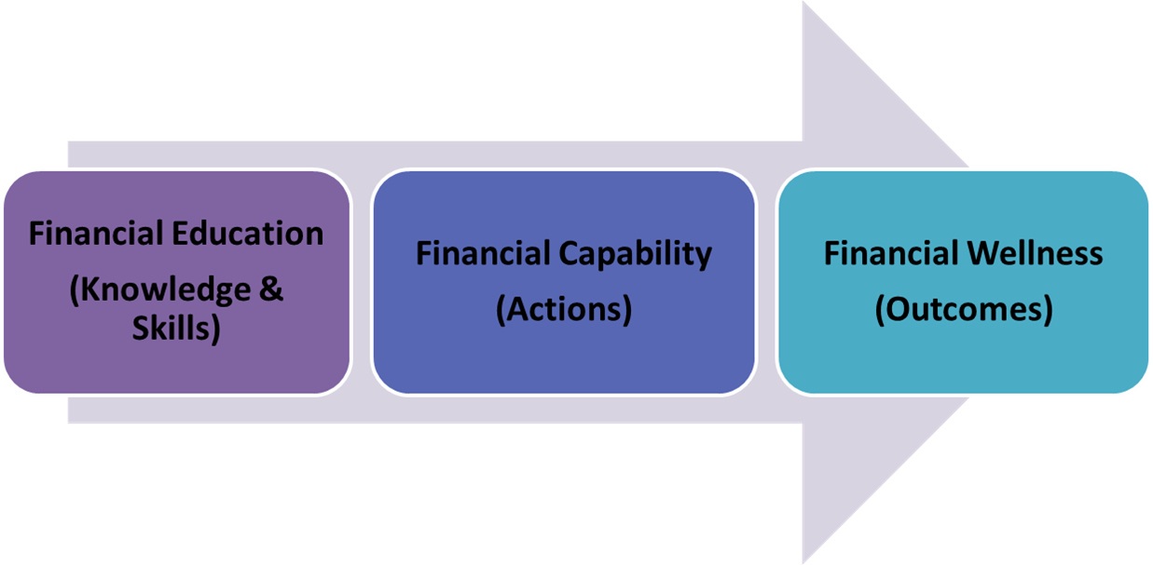
Financial Education vs. Financial Capability vs. Financial Wellness

Slide 16
Why is Financial Wellness Important?
Whether it is access to:
A quality education
Effective transition from school to work
Affordable (accessible) transportation, housing, (technology or long-term supports)
Enduring poverty and lack of economic empowerment will:
Diminish choices and quality of life within communities, and
Singularly diminish freedom, opportunity and self-determination
Notes:
DJ

Slide 17
So, What’s the Barrier?
Public attitudes
Low expectations of and within the disability community
Current partnerships don’t support savings and building a financial future
Regulations discourage saving for the future: retirement, emergencies, etc.
Notes:
Michael

Slide 18
Create New Expectations
Assume all people want to better their lives.
Engage people with disabilities in the conversation.
Provide simplified opportunities for individuals to improve their financial stability.
Acknowledge the limited financial literacy of all Americans, including those with disabilities.
Just as you assume competence, assume the desire to live beyond poverty.
Expect the systems to adjust to support this movement.
Notes:
Michael

Slide 19
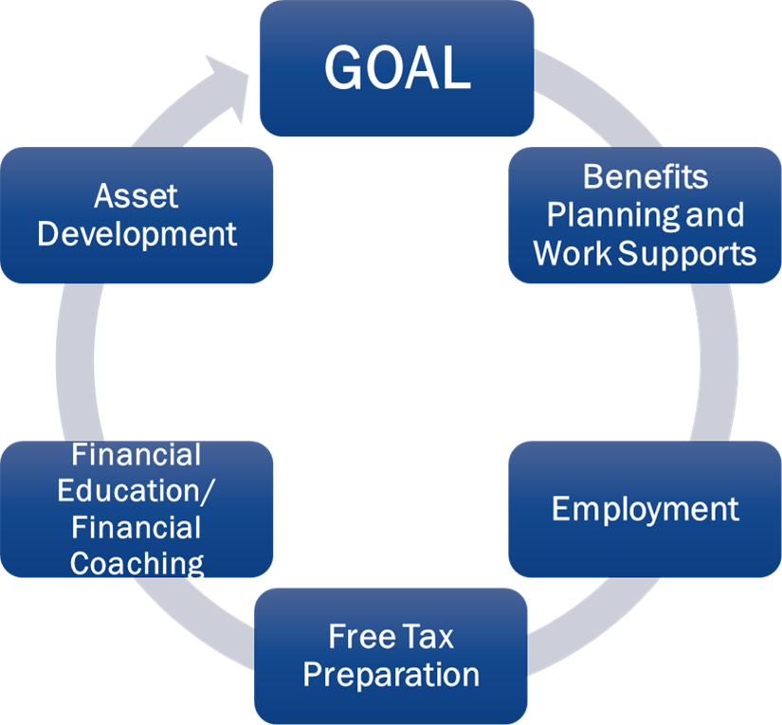
Five Key Strategies for Building Financial Wellness

Slide 20
Benefits Planning & Work Supports
It is important to look at all public benefits an individual receives and those they might be eligible for. It’s also important to consider the work supports attached to each.
Public Benefits – made available by federal, state or local government to assist people who need help with food, healthcare, housing and day-to-day-expenses.
SSA Work Supports – for SSI and SSDI disability beneficiaries. Work supports can lead to an increase in employment earnings, job retention and career development. There are a variety of work supports available to individuals if they qualify.
We will learn more about Benefits Planning and Work Supports in later modules.

Slide 21
Employment
Once an individual understands benefits planning and available work supports, this can lead to better employment outcomes. Employment helps build our wealth. There are different types of employment.
Full-time
Part-time
Self-Employment
Competitive Employment
Customized Employment
Supported Employment
Work Study
We will learn more about Employment in later modules.

Slide 22
Free Tax Preparation Services
People with disabilities often think they don’t need to file taxes due to low wages or they are afraid to receive a refund that would impact their public benefits. As a result, many people with disabilities do not receive a tax refund that could help them. They also miss out on many tax credits like the Earned Income Tax Credit and the Saver’s Credit.
During the COVID pandemic, many people received missing stimulus checks by filing their income tax returns. Others have yet to receive stimulus checks because they have not filed taxes. (It’s not too late as returns may be amended going back three years.) Many people are eligible for free tax preparation services by IRS-trained volunteers, saving people hundreds of dollars.
We will learn more about free tax preparation and favorable tax credits.

Slide 23
Financial Education/Financial Coaching
Financial Education is the possession of knowledge and the understanding of financial matters.
Financial Coaching is working with a financial coach to assist in achieving financial goals.
We will gain knowledge and understanding of finances that are needed to build financial wellness in each module.

Slide 24
Asset Development
As Benefits Planning and Work Supports, Employment, Free Tax Preparation and Financial Education/Financial Coaching are put into action, the next step is to open the door for individuals to build and protect their assets to achieve their goals. Assets might include:
Money saved
An ABLE account
House, car, other items owned
Education
Circle of Support
More!
Each of these categories has tools and resources that can help an individual to achieve optimal financial stability and bring them closer to reaching their financial goals. This training will explore the tools and resources for each of the Five Key Strategies.

Slide 25
Activity – American Dream
What is your American Dream?
What prevents you from achieving your goal?

Slide 26
Homework and Wrap Up
This Photo by Unknown Author is licensed under CC BY-SA

Slide 27
Questions

Slide 28
Evaluation and Closing
Don’t Forget!
Complete and turn in your evaluation.
Congratulations on completing your first steps towards improving YOUR financial wellness.
Thank YOU!
28

Slide 29
Financial Wellness for People with Disabilities

