Slide 1
Module 1: Money
2024

Slide 2
Welcome & Housekeeping
Introductions
Did everyone sign in?
PRE-Test Evaluation

Slide 3
Myth vs. Reality
Myth: I don’t need to know about money. My staff and family take care of everything.
Reality: Everyone needs money to have a good quality of life. Understanding money and managing the money you have will help you achieve your individual financial goals.

Slide 4
Agenda
Describe what money is and what we use it for.
Explain how money is earned.
Define assets.
Discuss why money is needed.
Learn what it means to budget money.

Slide 5
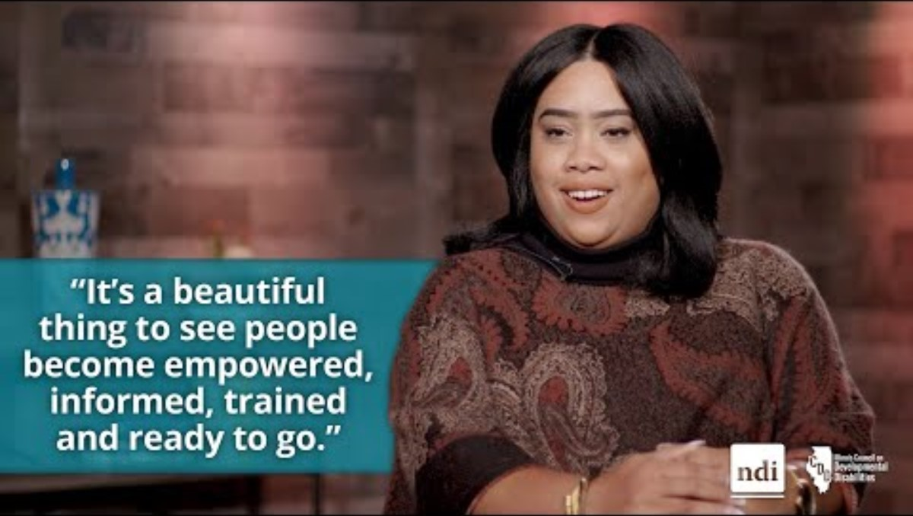
Financial Wellness is Empowering People Across Illinois

Slide 6
What Is Money and What Do We Use It For?
Money is something (such as coins or bills) we use as a way to pay for stuff and services and to pay people for their work.

Slide 7
Activity #1
What do we need money for in everyday life?
What are our expenses?
Keep in mind! Expenses are items we spend money on to have or use.

Slide 8
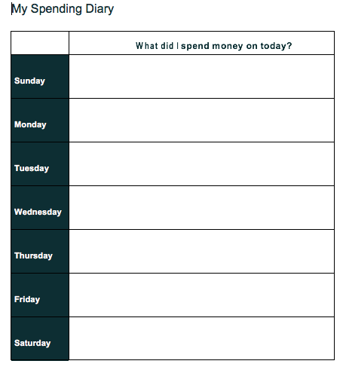
Homework Review
What Do YOU Spend Money On?

Slide 9
Needs vs. Wants (Slide 1 of 3)
Let’s look at what you just said you spend money on.
Would you identify those as needs or wants?

Slide 10
Needs vs. Wants (Slide 2 of 3)
Needs
  Things we have to pay for every month like food, transportation, rent, electricity, phone and more.
Wants
  Things we pay for that we enjoy and let us have fun like video games, movies, music and more.

Slide 11
Needs vs. Wants (Slide 3 of 3)
Sometimes we don’t have all the money we would like to pay for everything we want.
This is where we must determine what our needs and wants truly are.

Slide 12
How Are Some Different Ways We Get Money?
10

Slide 13
Money = Income
Earn money through a job
Supplemental Security Income = SSI
Social Security Disability Insurance = SSDI
Gifts

Slide 14
How Can You Earn More Money?
Go to school for higher learning
Gain experience in different areas at your current job
Develop additional skills
Each of these may lead to a promotion at your current job or lead you to an even better job with higher earnings.

Slide 15
Defining Assets
Which of these do you think are assets?
  House
  Money
  Education
  Car

Slide 16
What Are Assets?
Assets are the items we own that have value.
  Money you have in the bank
  Cash on hand
  Shares, retirement accounts, other investments
  Property you own
  A home or business
  Car or other type of vehicle
  Furniture and appliances
  Education and work experience

Slide 17
Importance of Asset Development
Why is the development of assets important to persons with disabilities?
  Assets provide greater financial security and independence.
  Assets improve our community participation and our quality of life.
  Overall, assets help us to build our financial wellness.

Slide 18
Activity #2
Who influences how we think about and manage our money?
Why do we need money?
16

Slide 19

Activity #3: My American Dream
Define YOUR American Dream.
What pictures and words describe your dream?
Vision for My American Dream
17

Slide 20
Activity #3: My American Dream (Continued)
How much would it cost to make your dream a reality?
How much would you have to save each week for a certain amount of time to make this dream a reality?

Slide 21

Homework Assignment
My Budget Worksheet
This Photo by Unknown Author is licensed under CC BY-SA

Slide 22

Questions

Slide 23
Evaluation and Closing
Don’t Forget!
Complete and turn in your evaluation and post-test.
Congratulations on completing your first steps towards improving YOUR financial wellness.
Thank YOU!
23

