Slide 1
Module 9: Getting ABLE Ready

Slide 2
Welcome & Housekeeping
Introductions
Did everyone sign in?
PRE-Test Evaluation

Slide 3
Agenda
What is an ABLE account?
Who is eligible?
What are qualified disability expenses?
What is the service provider’s role?
Resources for regular savings
Who to contact to open an IL ABLE Account or to learn more?

Slide 4



The ABLE Act – How It Helps
The ABLE Act allows eligible people with disabilities to save money to pay for qualified disability expenses, similar to the 529 accounts used by families to save for their children’s college education.
The ability to save money empowers individuals with disabilities to increase their money management skills, save for their futures and explore opportunities for increasing their income through employment and building a circle of support.

Slide 5
ABLE Savings and SSI
ABLE savings up to $100,000 are excluded from countable resources for SSI eligibility.
If the ABLE savings alone exceeds $100,000, by the resource limit, then your SSI benefits will be suspended until the resource limit is no longer exceeded; Medicaid is not affected. Non-ABLE resources must be under the resource limit for this rule to apply.
Contributions made directly into an ABLE account by family, friends, a special needs or pooled trust, or rolled over from a 529 college savings account are not countable income.
Interest on ABLE investments is not countable or taxable income when spent on qualified disability expenses.

Slide 6
ABLE Savings of Any Amount Does Not Change Eligibility for These Public Benefits
SSDI or Medicare;
Medicaid (any type);
FAFSA (financial aid);
HUD (housing assistance);
SNAP (Food Stamps);
Vocational Rehabilitation Services

Slide 7
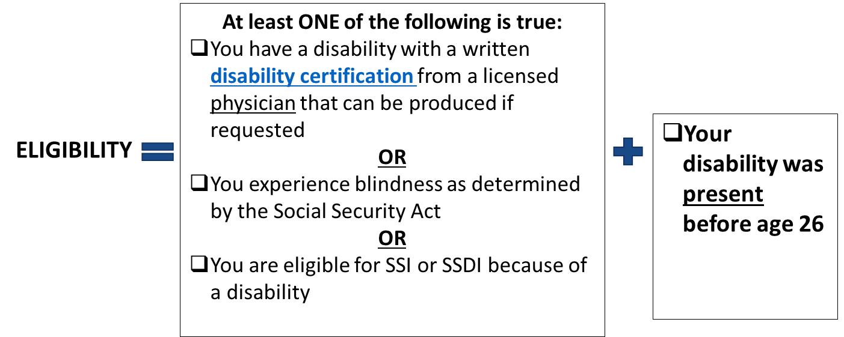
Who is ABLE-Eligible?
Disability Certification Information
    YOU DO NOT NEED TO BE CURRENTLY RECEIVING BENEFITS OF ANY KIND to be eligible to open an Illinois ABLE account.
    A person is allowed one ABLE account.
    To learn more, contact the IL ABLE Program directly:
    Call 1-888-609-8683
    (Monday - Friday, 8:00 am - 5:00 pm CT)
    Email: IL.ClientService@SaveWithABLE.com

Slide 8
When is Illinois ABLE Right for Me?
“I have extra money I want to save.”
“I have sometimes needed to spend down my savings.”
“A family member or a friend wants to give me a gift of money.”
“I work and earn money.”
“I have a special needs or a pooled trust; I don’t have or don’t want a special needs trust.”
“My family wants to help me afford my housing expenses.”
“I may need to qualify for Medicaid.”
“I have disability expenses I want to save for.”

Slide 9
How to Open an Illinois ABLE Account
Go to the Illinois ABLE website (accounts are opened online): SaveWithABLE.com/IL/Home.html
Choose the Start Saving Button;
  Read the Program Disclosure Statement
  Choose the Best Investment Option for You

Slide 10
How to Open an ABLE Account (Continued)
  Gather information:
    Your first and last name
    Residential street address
    Telephone number
    Social Security or taxpayer identification number
    Birth date
    Your personal bank account number (to pre-schedule contributions from your personal checking or savings account)
  You will be asked to set up passwords to review your account information and monthly statements; write these down.

Slide 11
Getting ABLE Ready
Defining the Savings Goal

Slide 12
Savings
Savings is money that is set aside for an emergency, a big purchase, a disability event, retirement or other things/opportunities that a person needs or wants to purchase.
Often individuals think that they do not have the money to save, or savings is for people who have lots of money. Even a small amount in a savings account can help when in a crisis situation, such as needing to move, traveling for a family emergency or paying for transportation comes up.
Saving money can make it possible to move to a safer neighborhood, buy a home, purchase assistive technology or attend events for people with disabilities.
ABLE Savings can be spent on qualified disability expenses.

Slide 13
Qualified Disability Expenses
May include expenses which improve the health, independence and quality of life for the ABLE account owner:
Assistive technology: standing wheelchair, smart home technology, glasses;
Disability-specific camp, conferences, travel and vacations;
Education, private school, college, tutoring;
Employment and Training: job coach, assistant, certificates and licenses;
Financial education / coaching / management, administrative services and legal fees;
Food, including grocery delivery fees;
Housing: rent, dorm, home purchase, utilities, property taxes;
Transportation: bus, taxi, train, vehicle purchase / repair;
Medical Needs: personal care assistance, items not covered by health insurance, elective surgery;
Funeral and burial expenses.

Slide 14
ABLE and Service Provider Role
Inform people of Illinois ABLE savings and investment account availability; provide a direct referral to the IL ABLE program for assistance.
  Call 1-888-609-8683 (Monday - Friday, 8:00 am - 5:00 pm CT)
  Email: IL.ClientService@SaveWithABLE.com
Help people to understand ABLE eligibility and what documentation helps to support eligibility;
Help person with a disability to identify an ABLE circle of support;
Help to identify who will open the ABLE account;
Encourage a strategy for regular savings;
Align ABLE savings and financial stability with programmatic goals:
  Advanced education and training;
  Increased employment;
  Increased financial stability for future.

Slide 15
Practitioners: How Do I Get Individuals / Families to Think About an ABLE Account?
Identify key moments in the conversation:
Examples of key moments to have the conversation about opening an ABLE Account. If the individual says,
  “I cannot save over $2,000 or I will lose my benefits.”
  “I have to spend down and go shopping because I am almost to $2,000 in my savings limit.”
  “I want to work, but I don’t want to work for free.”
  “My grandfather died and left me some money.”
  “I am keeping my money under the mattress.”
  “I would like to own a home someday.”
  Each of these statements are opportunities to introduce ABLE accounts.

Slide 16
Opportunities to Incorporate ABLE Account Information in Service Delivery
Intake process (if individual is not in a crisis situation)
  Utilize the Financial Well-Being Assessment to see where the individual is in terms of their current financial situation. The information the individual shares will provide multiple opportunities to encourage the individual to open an ABLE account.
While working towards an employment goal – incorporate financial supports, ABLE savings and financial goals into the Individual Employment Plan and into the Discovery Process;
Payday; a portion of income can be saved in ABLE;
Tax filing; a tax refund can be saved within an ABLE account; AND
Birthdays and holidays; a gift of money can be directly deposited into an ABLE account.

Slide 17
Opportunities to Incorporate ABLE Account Information in Service Delivery (Continued)
Benefits counseling session; costs for IRWEs or Blind Work Expenses can be saved and paid for from an ABLE account;
Transition programming – incorporate opening and savings within an ABLE account into the written Individual Education Plan;
Future planning with families and other supports; build a Circle of Support;
Post-crisis situation planning; discuss ideas about savings for emergencies;
Incorporate dialogue and money management activities into job clubs, support groups for the individual and for the family.

Slide 18
Practitioner’s Checklist to Getting
ABLE Ready
Build knowledge on ABLE accounts: review Getting ABLE Ready curriculum
  Review videos and other resources on the ABLE National Resource Center website: ablenrc.org
Print out materials on ABLE to have on hand when the conversation comes up with individuals you serve. Post fliers, post messaging on agency website and on organization’s social media accounts: ABLE National Resource Center Flier

Slide 19
Practitioner’s Checklist to Getting ABLE Ready (Continued)
Go to Illinois ABLE website and review application process and become familiar with it. You most likely will get questions from individuals who may not understand how to navigate the website: SaveWithABLE.com/IL/Home.html
  Call 1-888-609-8683 (Monday - Friday, 8:00 am - 5:00 pm CT)
  Email: IL.ClientService@SaveWithABLE.com
Identify contacts and relationships with Illinois ABLE and other ABLE experts to find answers to your questions;
Participate or host an ABLE awareness event for staff, families or individuals; or
Offer Spending Plan Development Workshops.

Slide 20
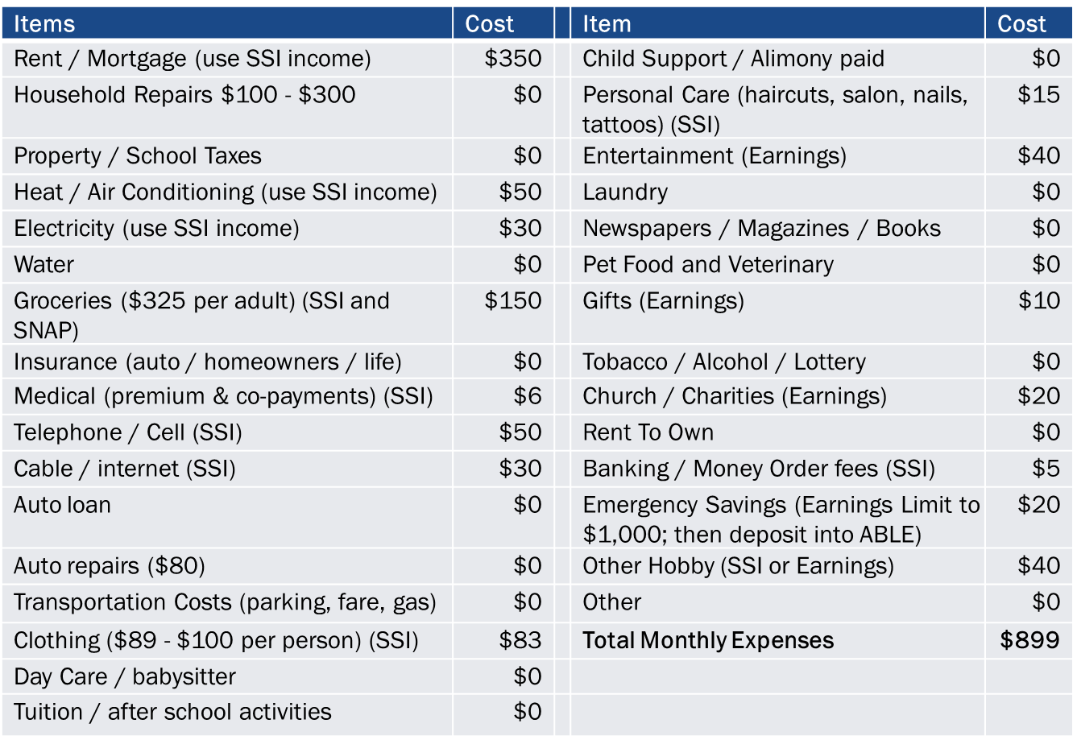
Example Spending Plan Expenses

Slide 21
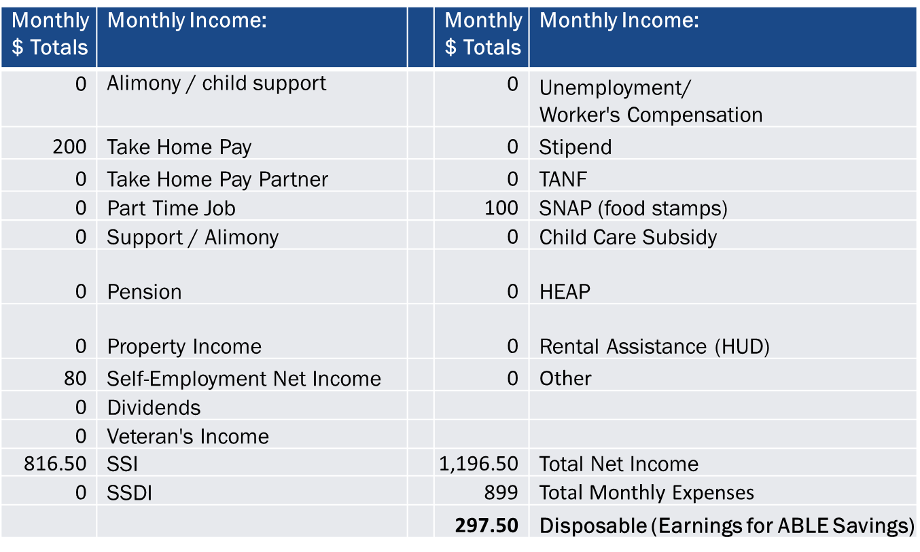
Example Spending Plan Income

Slide 22
Benefits of Defining Savings Contributions
Spending plan defines money needed to meet monthly expenses;
Spending plan offers opportunity to calculate amount to save regularly;
Income can be directed towards specific expenses;
Individuals who are working can contribute extra earned income
into ABLE:
  Contributions can include direct deposit for holidays and gifts up to $18,000 per year, for 2024;
  ABLE account owners who work and do not have an employer-sponsored retirement account can save up to an additional $14,580 within their ABLE account from their earned income, per year;
  To date, ABLE account owners are averaging $10,683 in ABLE savings; considerably more than the $2,000 limit that was imposed prior to the ABLE Act.

Slide 23
Sample: $297.50 ABLE Savings Per Month
Is there a way to congratulate the ABLE account owner for engaging in regular savings? (family, staff, friend, coach, financial counselor)
Will it help the account owner to initially set a short-term financial goal?
  This might help the person to earn more, increase regular monthly savings for short- and long-term goals.
With $297.50 saved in an ABLE account, how long before the person will save for their short-term or long-term financial goal?
Is the person working to their fullest capability? Can they work and save more?
Are there work supports that can help the person to save more or pay for work-related expenses such as Impairment Related Work Expenses (IRWEs)?

Slide 24
ABLE Resources
America Saves campaign to help individuals save money: Take the Illinois America Saves Pledge
ABLE National Resource Center
  ABLE National Resource Center Service Provider Toolkit
  ABLE National Resource Center Youth Transition Toolkit
  ABLE National Resource Center Ambassador Video
Illinois ABLE: SaveWithABLE.com/IL/Home.html

Slide 25
Resources and Tools
Better Money Habits
  Free online financial education videos and tools
  BetterMoneyHabits.BankOfAmerica.com/En
Hands on Banking
  Free online financial education curriculum
  HandsOnBanking.org/NDI
  NationalDisabilityInstitute.org/Downloads
FDIC Money Smart
  Free online financial education curriculum
  FDIC.gov/Consumers/Consumer/Moneysmart/Index.html

Slide 26

Questions

Slide 27
Evaluation and Closing
Don’t Forget!
Complete and turn in your evaluation and post-test.
Congratulations on completing your first steps towards improving YOUR financial wellness.
Thank YOU!

