Slide 1
Module 10: Guardianship Rights:
Who Is Responsible for What?

Slide 2
Welcome & Housekeeping
Introductions
Did everyone sign in?
PRE-Test Evaluation

Slide 3
Agenda
Define guardianship and what it means
Identify the role of a guardian
Discuss who is responsible for what between a guardian and an individual receiving guardianship
Learn about Supported Decision-Making in Illinois
Financial wellness education for individuals with a guardian

Slide 4
Myth vs. Reality
Myth: An individual with a guardian will have all their decisions made for them so they do not need to be educated about finances.
Reality: Everyone has a right to know about their finances and have some input, even if they are not making all the decisions. In order for the best financial wellness choices to be made, understanding the responsibilities of a guardian and the rights of an individual with a disability who has a guardian, is important for both parties. Also, not all guardianships give the guardian decision-making control over a person’s money. For example, there are limited guardianships that may just relate to healthcare decisions. It is important to know what level of guardianship has been granted by the court.

Slide 5
What Is Guardianship?
Guardianship is the appointment by the court for a surrogate/substitute decision-maker for a person who is over the age of 18 and is unable to make decisions due to some level of incapacity. When a person reaches the age of 18, they receive all of their adult legal rights. If they are unable to understand these rights and exercise them due to lack of decisional capacity, a judge can appoint a guardian to protect that individual and make all or some legal decisions for them.
Defined by the Illinois Guardianship

Slide 6
When Is Guardianship Needed?
Illinois Guardianship and Advocacy Commission states guardianship is needed when:
  A person is unable to make and communicate responsible decisions regarding their personal care or finances due to a mental, physical or developmental disability. A mental, physical or developmental disability alone is not sufficient for the appointment of a guardian. The fact that a person is elderly, mentally ill or developmentally or physically disabled does not necessarily indicate a need for guardianship. The extent to which a guardian is allowed to make decisions for a person is determined by the court based on a thorough clinical evaluation and report.
Source: A Guide to Adult Guardianship

Slide 7
True or False?
Guardianships are all the same and, once an individual is appointed a guardian, the guardian is able to make ALL decisions for the individual they have been appointed to assist.
FALSE

Slide 8
Types of Guardianships in Illinois
Plenary (Full) Guardianship:
  Most restrictive form of guardianship.
  All adult rights are removed from the protected person and transferred to the guardian, who generally makes all decisions about services, healthcare, personal care and/or finances for the person with a disability.
Limited Guardianship:
  Less restrictive form of guardianship.
  Depending on the decision-making capacity of the person with a disability, this type of guardian is only able to exercise rights for the protected person in the areas specified by the court.
  Five major types of limited guardianship: medical, financial, education, residential and habilitation (which includes daily support services).

Slide 9
Types of Guardianships in Illinois (continued)
Temporary Guardianship:
  Granted in emergency situations to safeguard the alleged person with a disability.
  Granted for the period between filing of a petition for guardianship and the conclusion of the court hearing where the need for guardianship is decided.
  Lasts no longer than 60 days and is only intended as a short- term remedy where a demonstrated harm or emergency exists.

Slide 10
Activity #1
What do you think are some requirements for being a guardian and who might serve as a guardian?

Slide 11
Being a Guardian in Illinois
Must be at least 18 years of age
Must be of sound mind
Cannot have been convicted of a serious crime
Must be acceptable to the court
Must be a legal resident of the United States
Able prove to the court they are able to provide guardianship support for the person in the areas named and be active in their life.
Any agency, public or private, may serve as guardian if the court finds them capable of providing active guardianship support.
An agency providing residential services (where you live) to a person with a disability may not be a guardian to ensure there are no conflicts of interest.
A banking institution may be appointed guardian of money or property for a person with a disability, often called their estate, but not a guardian of the person.

Slide 12
Who Decides?
The court will determine the need for guardianship and who should serve as the guardian.
Family members are not automatically named the legal guardian for their relative with a disability.
A family member may petition to be named guardian and the person with a disability may express a preference as to his or her guardian.
  If the person with a disability expresses a preference, the judge will take this into consideration. However, the judge appoints whomever they feel will make the best guardian and act in the best interest of the person with a disability, regardless of the party's relation to the person.
Only a judge can appoint a guardian.

Slide 13
Activity #2
What kinds of decisions do you think individuals with developmental disabilities might need help with from their appointed guardian?

Slide 14
Examples
Paying bills
Choosing a bank account
What to buy
Managing money and making major purchases
Where to live
Which doctor to go to and when to go
Having a medical procedure done
Where to work
Living situations
Marriage

Slide 15
Guardian Responsibilities
Appointed to make decisions about many different aspects of daily life.
Legally and ethically required to make these decisions in the “best interest” of the individual they are supporting, taking into consideration what the individual wants.
Decisions should be customized to meet the needs of the individual, not limit the individual from making their own decisions about aspects of their life that they are capable of controlling.
Should only make decisions for an individual when they are not capable of making a good or informed decision on their own.

Slide 16
Individual’s Rights
Individuals that have a guardian have the right to:
  Feel safe
  Know legally which decisions a guardian can make and which decisions can be made on their own
  Have their money used for their needs
  Have opportunities to practice money-management skills
  Be treated with respect by their guardian

Slide 17
Individual’s Rights (Continued)
  Talk with their guardian about what they want and need
  Ask questions about the decisions being made for them
  Choose their friends and activities as much as possible
  Participate in conversations about them
  Go to school or get a job
  Live as independently as possible

Slide 18
Illinois Supported Decision Making Act
Act signed into law by the Illinois governor August of 2021 and effective February 27, 2022.
A model of assistance for persons with an intellectual or developmental disability (principal) who have a range of making decisions for themselves to receive assistance from someone they trust (supporter).
Does not eliminate guardianships. Guardianships will continue to be an option for individuals with disabilities who lack decisional capacity as determined by the courts.

Slide 19
Supported Decision-Making Agreements
Signed by both the individual with a disability, their identified supporter and two witnesses defining what type of assistance will be provided based on the individual’s unique needs and preferences.
The agreements are based on an individual's level of ability and identified areas of needed support.
A supporter could help interpret information, weigh options, and communicate decisions based on the input and needs of the individual.
More information available on Supported Decision Making in Illinois

Slide 20
Let’s Talk
Based on what we have talked about so far, do you think it is important for an individual who has a guardian to be educated about their financial wellness?
Why?
It is important for ALL individuals to learn about financial wellness, regardless of whether they have a guardian or not.

Slide 21
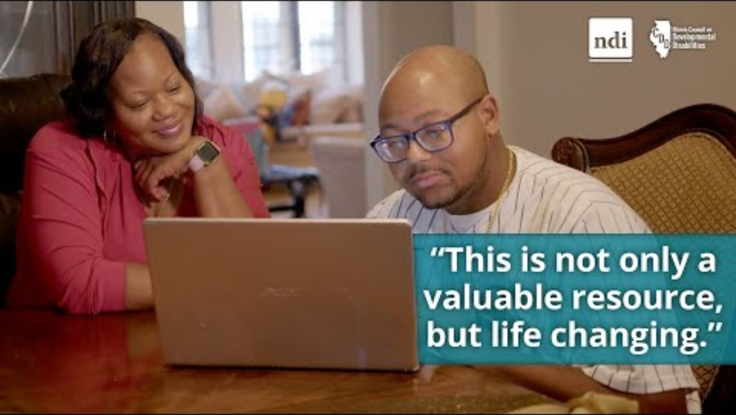
Meet Kimberly - Financial Wellness is more than personal for this parent advocate

Slide 22
Financial Wellness Strategies and Techniques
Create an American Dream board. Include decisions to be made and identify the ones where a guardian may need to help.
Take some financial education courses. A guardian can review and discuss together.
Discuss how money is spent and ways to save to reach goals together.
Find out about ABLE account eligibility and work together to open one to help save for disability-related expenses.
Communicate wants and needs directly with the guardian.
If interested in working, talk about possibilities of different types of jobs that might be an option. Discuss and use eligible work supports
Only discuss financial and personal information with trustworthy people known personally.
Ask questions.

Slide 23

Questions

Slide 24
Evaluation and Closing
Don’t Forget!
Complete and turn in your evaluation and post-test.
Congratulations on completing your first steps towards improving YOUR financial wellness.
Thank YOU!

